Slide 1

Chapter 2- Machine Learning
Book: Maria Schuld and Francesco Petruccione, “Machine Learning with Quantum Computers”, Springer, 2021, 2nd Ed.

Slide 2
Machine Learning- AI versus ML
Machine learning is a discipline with strong ties to computer science and statistics, originally emerged as a sub-field of artificial intelligence research
Artificial intelligence (AI) is a machine that is good at human-like tasks such as reasoning, navigating, and interacting.
Machine learning can be seen as one particular flavour of AI, which finds patterns in data to make predictions in unknown situations.
AI
ML

Slide 3
Machine Learning-Properties
Large data: the attraction of machine learning, therefore, lies in its capability to learn from extremely large data sets that only computers can process.
Complex Pattern: it is difficult to hand-shape a model of dynamic equations that captures the mechanism producing the data. Machine learning instead starts with a very general mathematical model, and uses data to adapt it to the case. A process called “training”

Slide 4
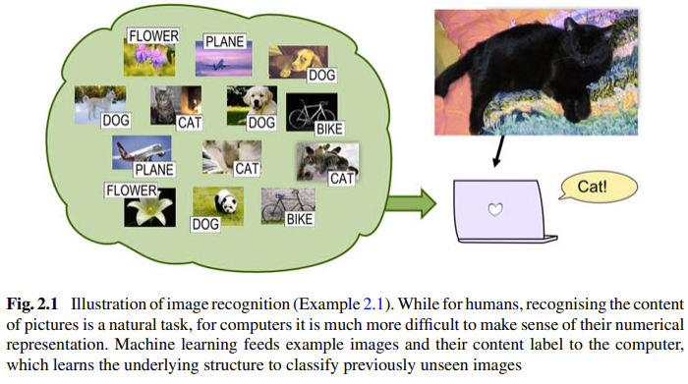
Example of ML problems #1: Image recognition
While humans easily identify objects from visuals, teaching computers to do so is challenging due to the complex link between pixel values and content. Machine learning trains computers with labeled images to approximate this relationship.
A key example is the MNIST dataset, where algorithms now recognize handwritten digits with near-perfect accuracy.
Image recognition plays an important role in many applications such as security, database sorting and recommendation systems, and can be considered the first big success story of commercial machine learning.

Slide 5
EXAMPLE of ml problems #2: Time series forecasting
A time series is a set of data points recorded in consecutive time intervals.
An example is the development of the global oil price. Imagine that, for every day in the last two years, one also records the values of important macroeconomic variables such as the gold price. These indicators will likely be correlated to the oil price, and there will be many more independent variables that are not recorded.
A machine learning task could be to predict on which day in the upcoming month oil will be cheapest.

Slide 6
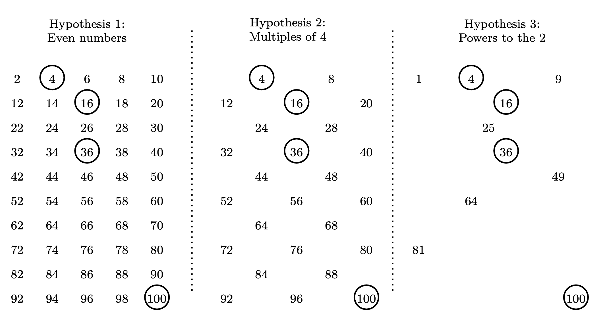
Example of ML problems #3: Hypothesis guessing
One approach to machine learning is to understand it as a hypothesis selection task.
Example: a candidate is given a list of integers between 1 to 100 (e.g. 4,16, 36, 100), and has to complete the series. The person has to guess the hypothesis or the rule with which these numbers are randomly generated.
Some hypothesis can be seen in the
picture, but prefer those that have a
Smaller amount of options (numbers,
in this example).
In this example of hypothesis testing the circled numbers are given with the task to find a natural number between 1 and 100 generated by the same rule.

Slide 7
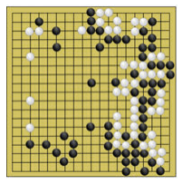
Example of ML problems #4: Board games
A traditional application for machine learning is to program machines to play games, such as chess. The machine—in this context called an agent—learns, it gets rewarded for successful policies and punished for unsuccessful ones.
While the world champion in chess was beaten by machine learning software as early as the 1990s, the game “Go” is more complex.
There are more possible positions of marbles on the board than atoms in the universe. However, one of the leading masters of Go had to admit defeat to computer software in 2016, namely Google’s AlphaGo
The black and white marbles in the board game “Go” can be arranged in a vast number of configurations

Slide 8
Examples of ML problems
In these 4 examples, i.e. 1. image recognition, 2. time series forecasting 3. hypothesis guessing and 4. board gaming, the data was given respectively by images and their content, a time series, integers, configurations of a board game.
If the training consists of input-output pairs, such as examples 1 and 2, one peaks of supervised learning.
Those data that do not come with target outputs, such as example 3, poses an unsupervised learning
Problems similar to example 4 in which an agent gets rewarded or punished according to a given rule for its decisions, is called reinforcement learning. In this approach, the agent learns an optimal strategy by trial and error.

Slide 9
DEEP learning
Often reinforcement learning involves solving supervised and unsupervised learning problems in a game-like manner.
In all 3 areas, deep learning is involved and has pushed the limits of what machines can do.
Deep learning is not so much a different learning, although usually needs large datasets, but a regime of certain models, strategies, and data types that helps researchers with improving performance.
In the following we will focus on supervised and unsupervised learning as two fundamental learning approaches.

Slide 10
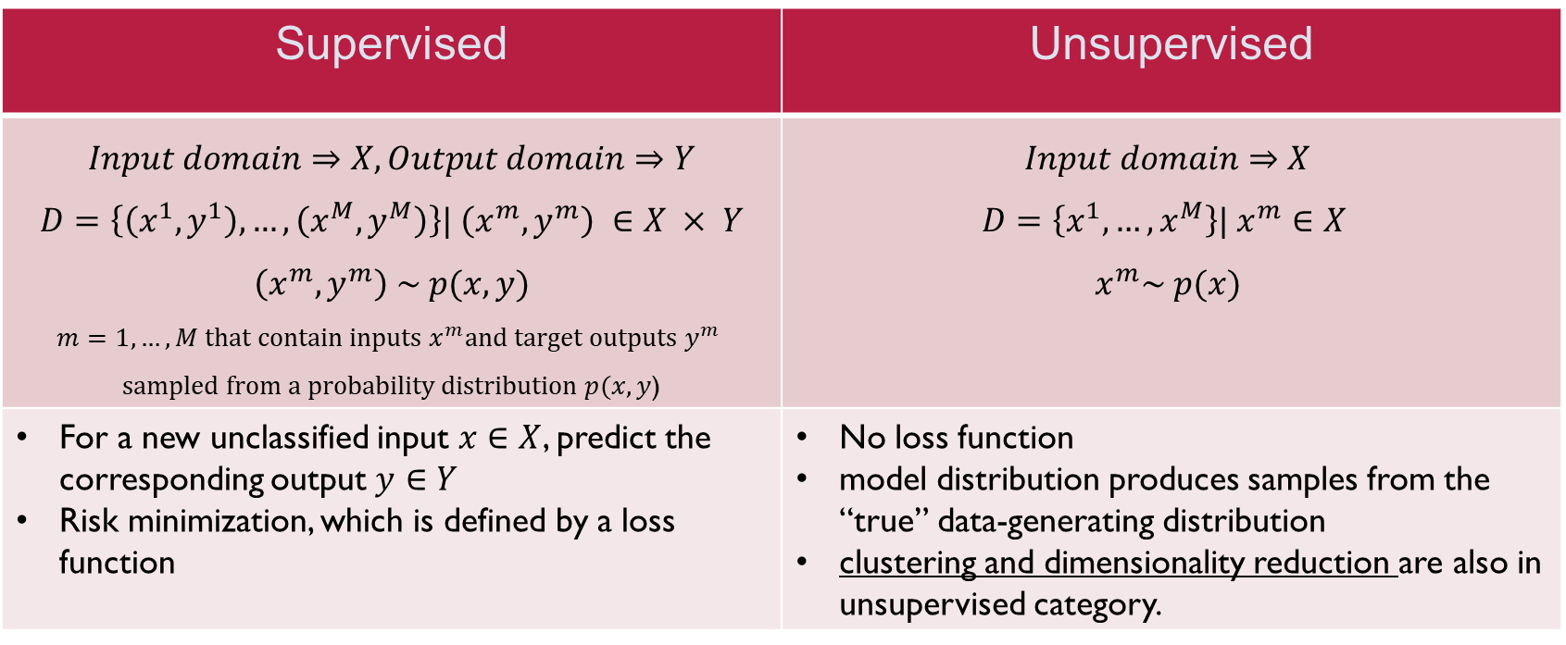
Supervised vs Unsupervised
Supervised | Unsupervised
$$Input domain⇒X, Output domain⇒Y$$ $$D=\left\{\left(x^{1}, y^{1}\right), …,\left(x^{M}, y^{M}\right)\right\}| \left(x^{m}, y^{m}\right) ∈X × Y$$ $$\left(x^{m}, y^{m}\right) \sim p(x, y)$$ $$m=1,…,M that contain inputs x^{m}and target outputs y^{m}$$ $sampled from a probability distribution p(x, y$) | $$Input domain⇒X$$ $$D=\left\{x^{1}, …,x^{M}\right\}| x^{m}∈X$$ $$x^{m}\sim p(x)$$
For a new unclassified input $x∈X$, predict the corresponding output $y∈Y$ Risk minimization, which is defined by a loss function | No loss function model distribution produces samples from the “true” data-generating distribution clustering and dimensionality reduction are also in unsupervised category.

Slide 11
Supervised vs Unsupervised
ML solves both supervised and unsupervised problems by defining a model family which is a set of functions that maps input to outputs, or of distributions p over the inputs (and possibly over the outputs.).
From these models, one picks the best model to reproduce the data.
In supervised learning this task is known as risk minimization.
The idea of “best model” or “risk” is defined by a loss function that measures the disparity between the model’s predicted output for an input and the target output.
The best model is the one that minimizes the expected average loss over all possible data
In unsupervised learning, we do not have a loss function comparing predictions and labels, but we can evaluate the distance between the true probability distribution and the model distribution.

Slide 12
Supervised vs Unsupervised
The challenge in ML: one has to pick the best model without having access to all the data
The art of learning is to select a model that generalizes from limited examples to the entire domain of the data
Typically, ML models are parametrized which means they depend on a set of parameters.
Each set of parameters defines one particular model in the family.
Picking the best model translates to an optimization task, in which the best parameter needs to be found

Slide 13
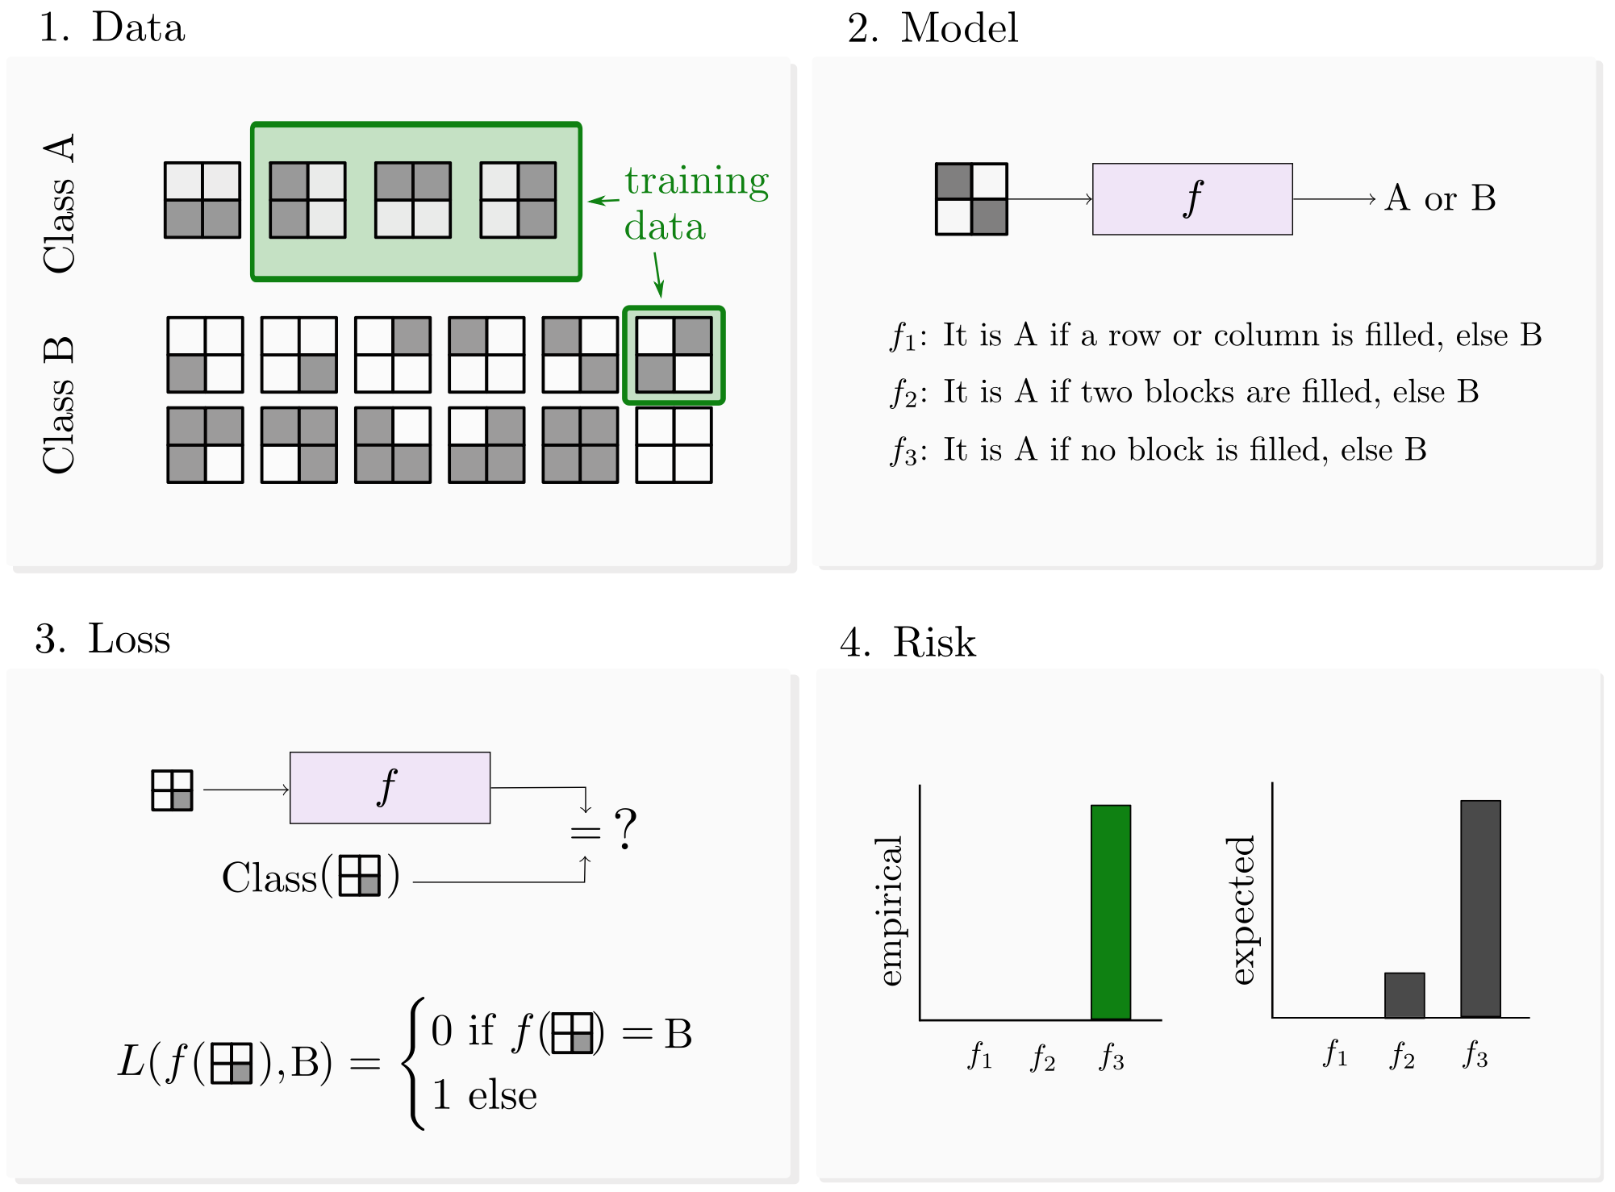
Illustration of how to solve a supervised learning problem. We are given four samples from the bars and stripes dataset (1), as well as a family of three models (here the models are non-numerical hypotheses) that map a sample to class A or B (2), and a loss function that is 1 if the model’s prediction is wrong and 0 else (3). The risk of the three models over all the data (4, right) clearly shows that f1 is the best model (i.e., the model with the lowest risk). However, the empirical risk (4, left), which only takes into account the four data samples we have access to, evaluates models f1 and f2 as equally good. This shows the challenge of machine learning: using a subset of data, one needs to find a model which performs well on all data

Slide 14

Ingredients of a Learning Problem
Data
Model
Loss
ML

Slide 15
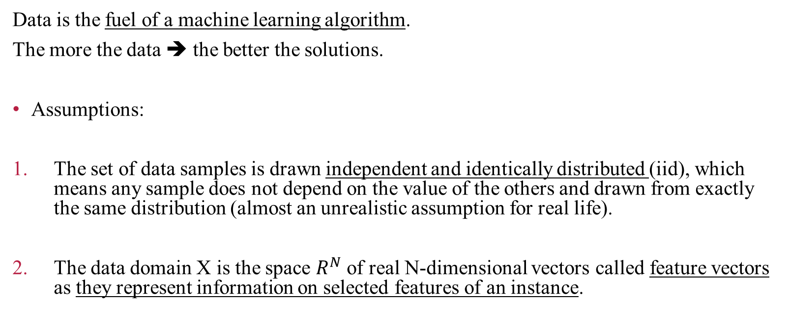
Data
Data is the fuel of a machine learning algorithm.
The more the data ➔ the better the solutions.
Assumptions:
The set of data samples is drawn independent and identically distributed (iid), which means any sample does not depend on the value of the others and drawn from exactly the same distribution (almost an unrealistic assumption for real life).
The data domain X is the space $R^{N}$ of real N-dimensional vectors called feature vectors as they represent information on selected features of an instance.

Slide 16
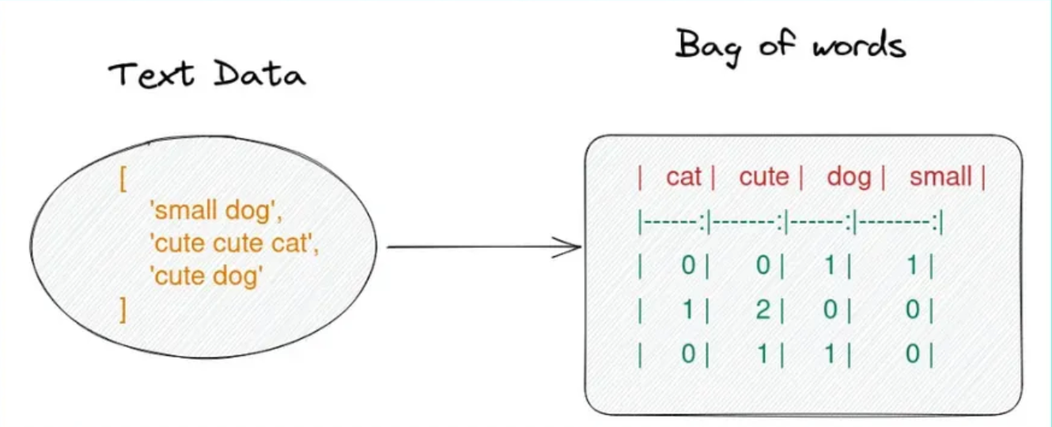
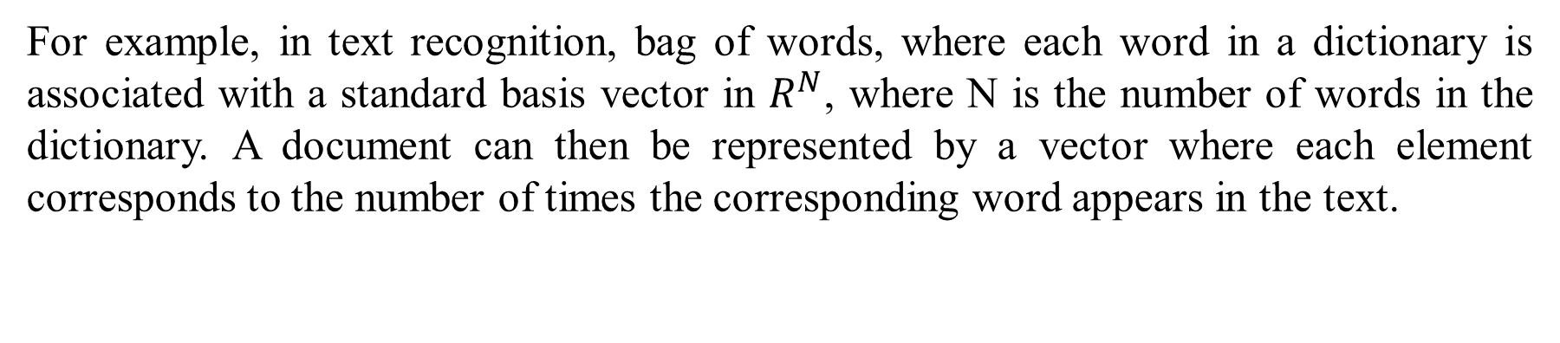
Example: text recognition
For example, in text recognition, bag of words, where each word in a dictionary is associated with a standard basis vector in $R^{N}$, where N is the number of words in the dictionary. A document can then be represented by a vector where each element corresponds to the number of times the corresponding word appears in the text.

Slide 17
Data Preparation
Data is often pre-processed, which has traditionally been an important step to improve the predictive power of an algorithm. Recently, with deep learning methods, data preparation has become less central to ML.
Some quantum algorithms, however, require careful preprocessing.
Feature selection: the choice of which features of an instance to consider.
Feature scaling: changes some statistical properties of the data.
Feature engineering: has the goal of hand-crafting powerful features, e.g. combining several features in the original dataset to a single one.

Slide 18
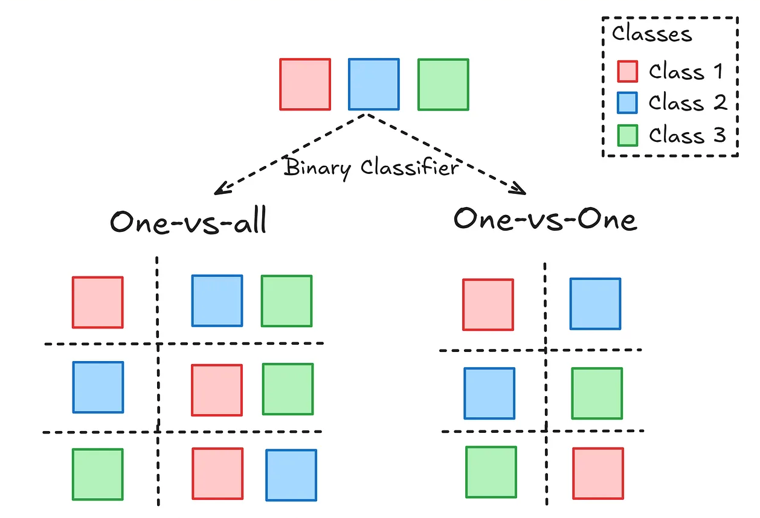
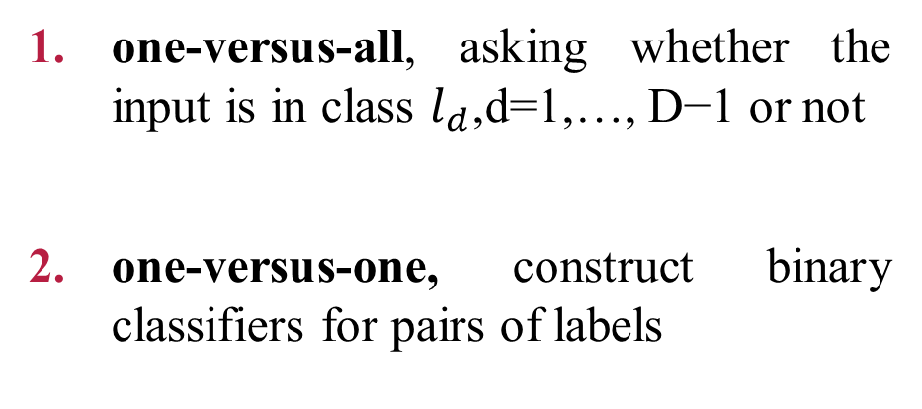
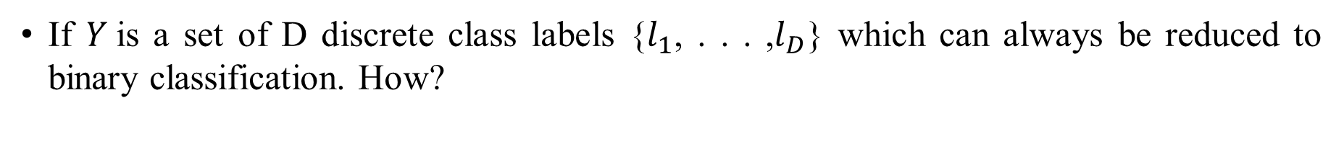
Multi-class classification
If $Y$is a set of D discrete class labels {$l_{1}$, . . . ,$l_{D}$} which can always be reduced to binary classification. How?
one-versus-all, asking whether the input is in class $l_{d}$,d=1,…, D−1 or not
one-versus-one, construct binary classifiers for pairs of labels

Slide 19
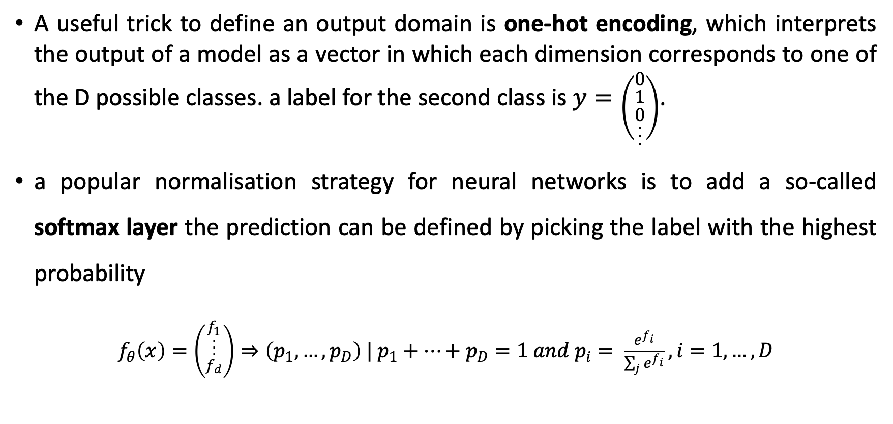
Output domain
A useful trick to define an output domain is one-hot encoding, which interprets the output of a model as a vector in which each dimension corresponds to one of the D possible classes. a label for the second class is $y=\left({0 \atop \begin{aligned}1 \\ 0 \\ . \\ . \\ .\end{aligned}}\right)$.
a popular normalisation strategy for neural networks is to add a so-called softmax layer the prediction can be defined by picking the label with the highest probability
$f_{θ}\left(x\right)=\left({\begin{aligned}f_{1} \\ . \\ . \\ .\end{aligned} \atop f_{d}}\right)⇒\left(p_{1}, …,p_{D}\right) | p_{1}+…+p_{D}=1 and p_{i}= \frac{e^{f_{i}}}{\sum_{j}{e^{f_{i}}}}, i=1,…, D$

Slide 20
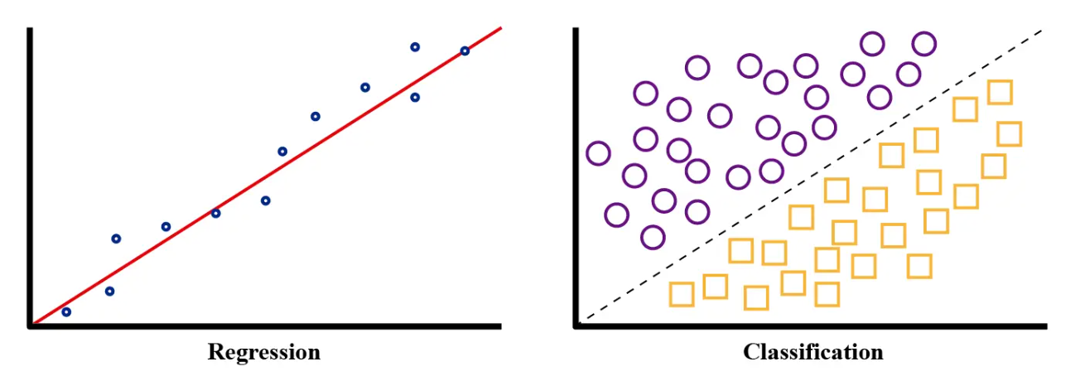
Regression
Regression, refers to problems in which the prediction y is continuous-valued but does not necessarily have a probabilistic interpretation.
Classification => Regression, by switching to continuous variables and adjusting the functions or distributions accordingly
Regression => Classification, outcome of regression can be discretised i.e., y > 0 → 1 and y ≤ 0 → 0

Slide 21
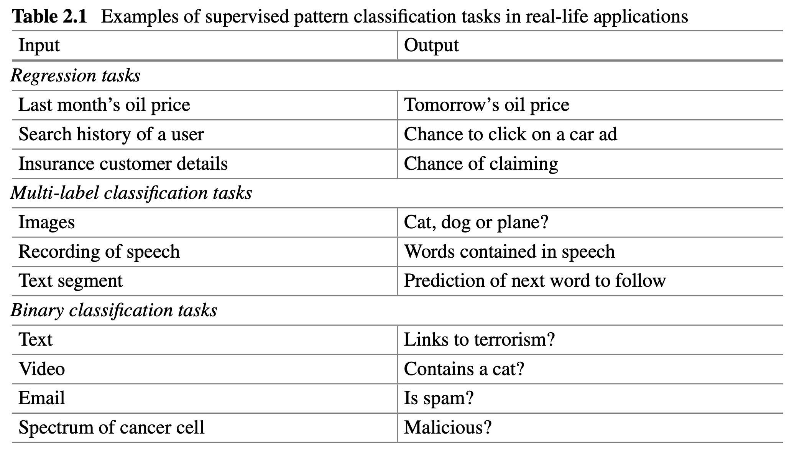
good solutions to any of these problems are worth billions of dollars in military, medical, financial, technical or commercial applications.

Slide 22
Model
The term “model” and its role in machine learning is comparable with the term “state” in quantum mechanics—it is a central concept.
define models in machine learning as functions, distributions, algorithms, or rules that reproduce the properties of a set of data samples.
We want to distinguish between deterministic and probabilistic models

Slide 23
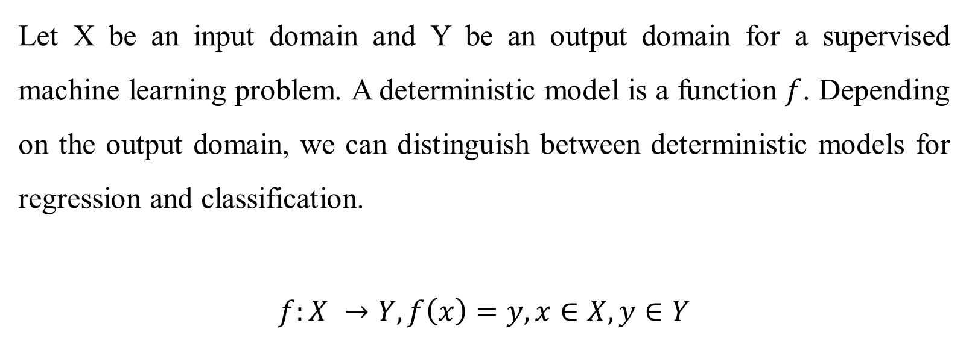
Deterministic Model
Let X be an input domain and Y be an output domain for a supervised machine learning problem. A deterministic model is a function $f$. Depending on the output domain, we can distinguish between deterministic models for regression and classification.
$$f:X →Y, f\left(x\right)=y, x∈X, y∈Y$$

Slide 24
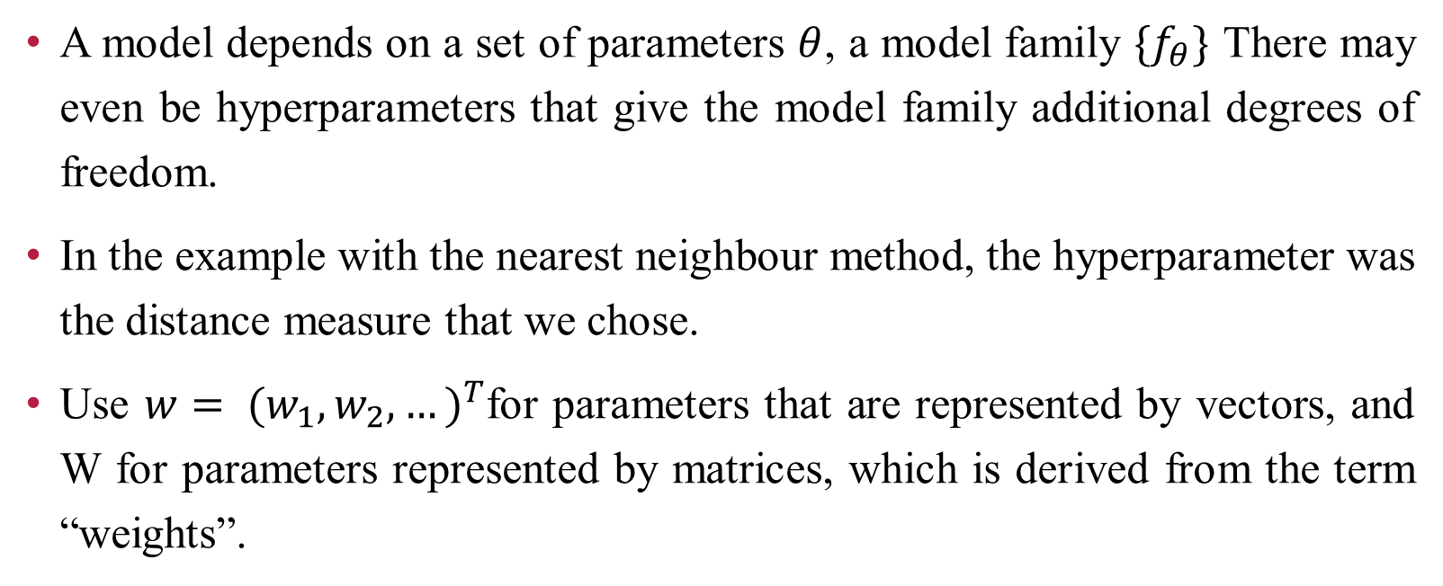
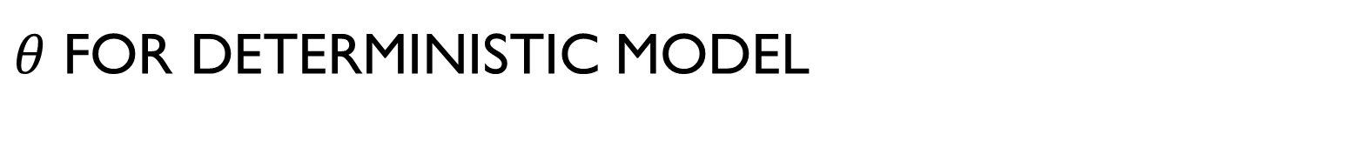
$θ$ For Deterministic Model
A model depends on a set of parameters $θ$, a model family $\{f_{θ}\}$ There may even be hyperparameters that give the model family additional degrees of freedom.
In the example with the nearest neighbour method, the hyperparameter was the distance measure that we chose.
Use $w= {(w_{1},w_{2}, …)}^{T}$for parameters that are represented by vectors, and W for parameters represented by matrices, which is derived from the term “weights”.

Slide 25
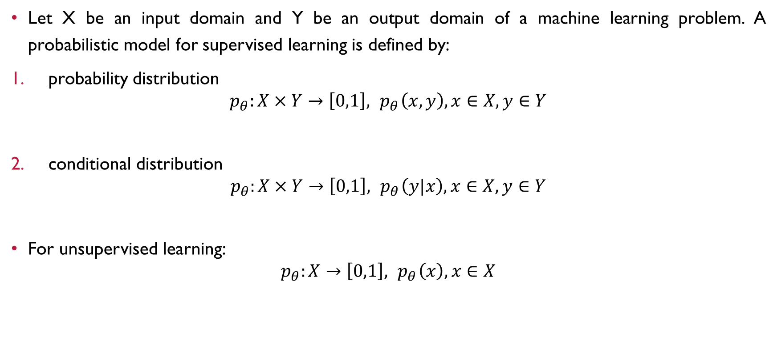
Probabilistic Model
Let X be an input domain and Y be an output domain of a machine learning problem. A probabilistic model for supervised learning is defined by:
probability distribution
$$p_{θ}:X×Y→\left[0,1\right],{ p}_{θ}\left(x,y\right), x∈X, y∈Y$$
conditional distribution
$$p_{θ}:X×Y→\left[0,1\right],{ p}_{θ}\left(y|x\right), x∈X, y∈Y$$
For unsupervised learning:
$$p_{θ}:X→\left[0,1\right],{ p}_{θ}\left(x\right), x∈X$$

Slide 26
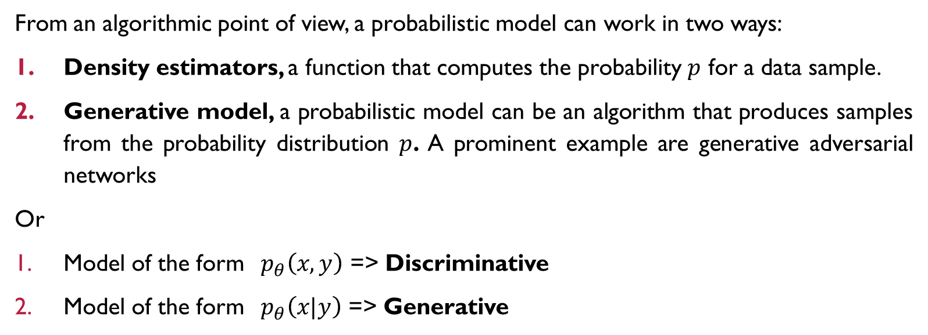
Probabilistic Model
From an algorithmic point of view, a probabilistic model can work in two ways:
Density estimators, a function that computes the probability $p$ for a data sample.
Generative model, a probabilistic model can be an algorithm that produces samples from the probability distribution $p$. A prominent example are generative adversarial networks
Or
Model of the form ${ p}_{θ}\left(x,y\right)$ => Discriminative
Model of the form ${ p}_{θ}\left(x|y\right)$ => Generative

Slide 27
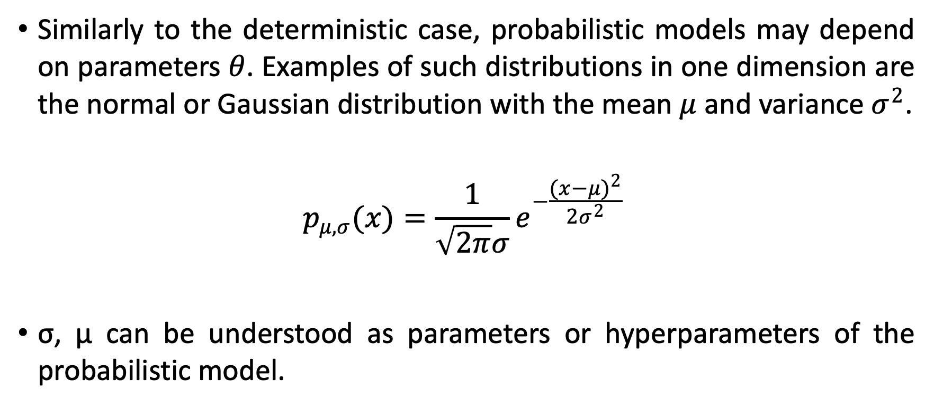
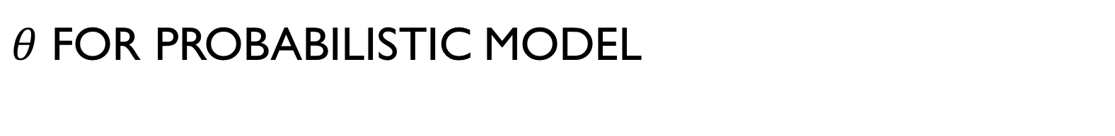
$θ$ For Probabilistic Model
Similarly to the deterministic case, probabilistic models may depend on parameters $θ$. Examples of such distributions in one dimension are the normal or Gaussian distribution with the mean $μ$ and variance $σ^{2}$.
$$p_{μ,σ}(x)=\frac{1}{\sqrt{2π}σ}e^{−\frac{{(x−μ)}^{2}}{2σ^{2}}}$$
σ, μ can be understood as parameters or hyperparameters of the probabilistic model.

Slide 28
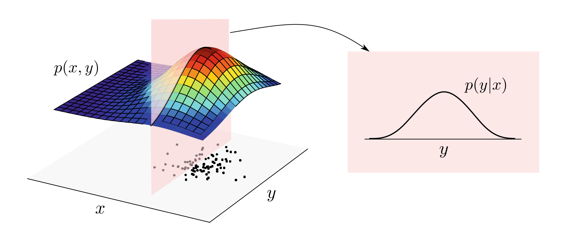
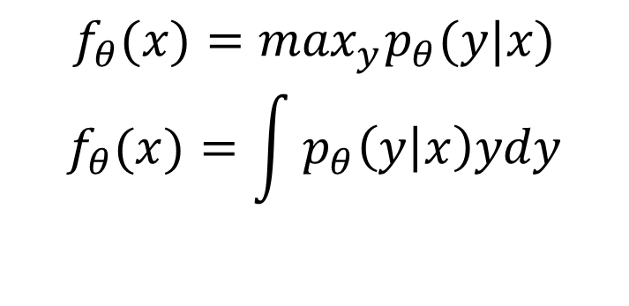
Model output?
If a probabilistic model defines a distribution p(x, y) over the data, one can derive a conditional distribution over the outputs given the input p(y|x) by marginalising or “slicing through” the model. The maximum or mean of the conditional distribution can be interpreted as the output of the model
$$f_{θ}(x)=\max_{y}p_{θ}(y|x)$$
$$f_{θ}(x)=\int{p_{θ}\left(y | x\right)ydy}$$

Slide 29
Deterministic and Probabilistic Relation
The deterministic and probabilistic approach to machine learning is highly interlinked. However, the logic of model design and training is sometimes slightly different for the two perspectives.
Deterministic => Probabilistic
The continuous outcome of a deterministic model can be turned into a probability distribution for classification tasks.
Introducing noise into a model
Probabilistic => Deterministic
interpret the most likely label for a given input as the prediction

Slide 30
Finally…
When machine learning researchers speak of a model, they may refer to:
The entire family of models including hyperparameters
=> neural networks
A specific configuration of hyperparameters but general parameters
=> a single-layer neural network with sigmoid activation
single specific model from the family whose parameters have been fixed
=> a trained single layer neural network with sigmoid activation

Slide 31
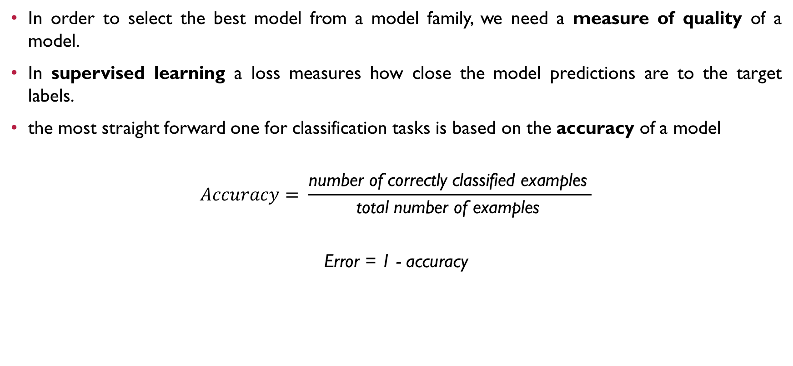
Loss
In order to select the best model from a model family, we need a measure of quality of a model.
In supervised learning a loss measures how close the model predictions are to the target labels.
the most straight forward one for classification tasks is based on the accuracy of a model
$$Accuracy= \frac{\text{number} \text{of} \text{correctly} \text{classified} \text{examples} }{\text{total} \text{number} \text{of} \text{examples} }$$
Error = 1 - accuracy

Slide 32
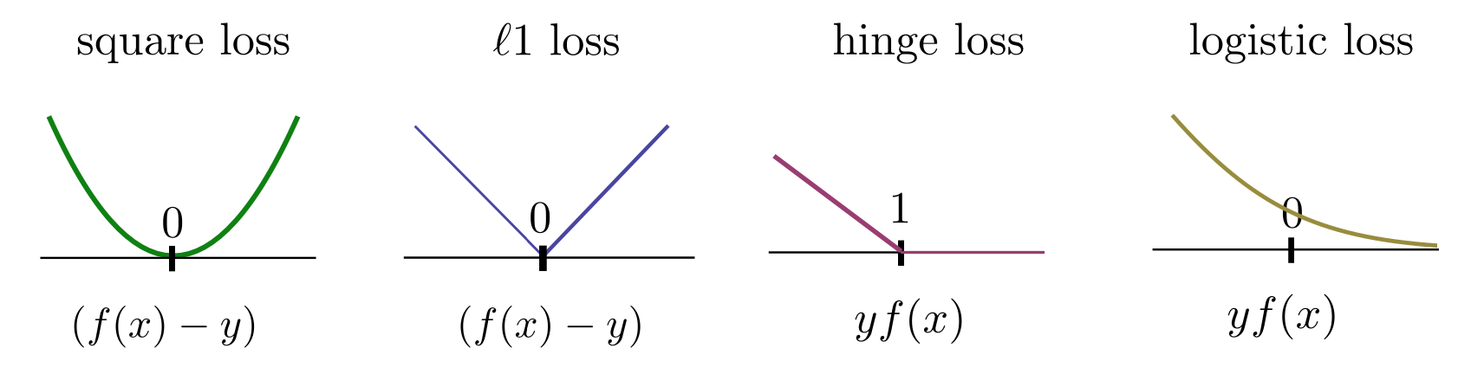
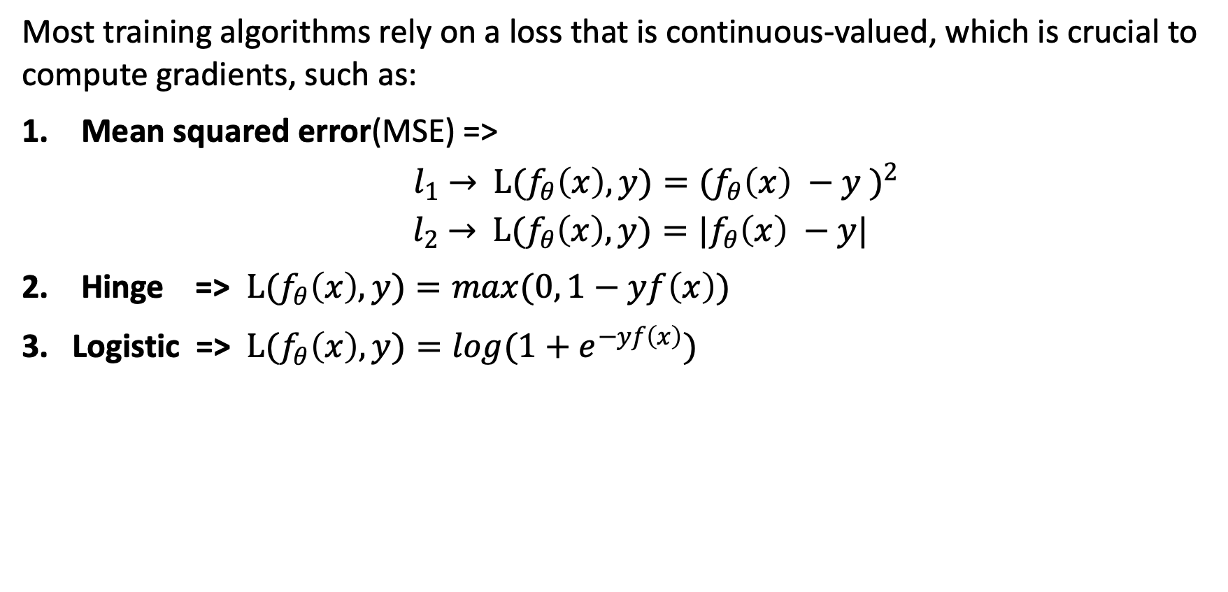
Loss
Most training algorithms rely on a loss that is continuous-valued, which is crucial to compute gradients, such as:
Mean squared error(MSE) =>
$l_{1}$ $→$ $L(f_{θ}\left(x\right), y)={{(f}_{θ}\left(x\right) −y )}^{2}$
$l_{2}$ $→$ $L(f_{θ}\left(x\right), y)={|f}_{θ}\left(x\right) −y|$
Hinge => $L(f_{θ}\left(x\right), y)=max(0, 1−yf\left(x\right))$
3. Logistic => $L(f_{θ}\left(x\right), y)=log(1+e^{−yf\left(x\right)})$

Slide 33
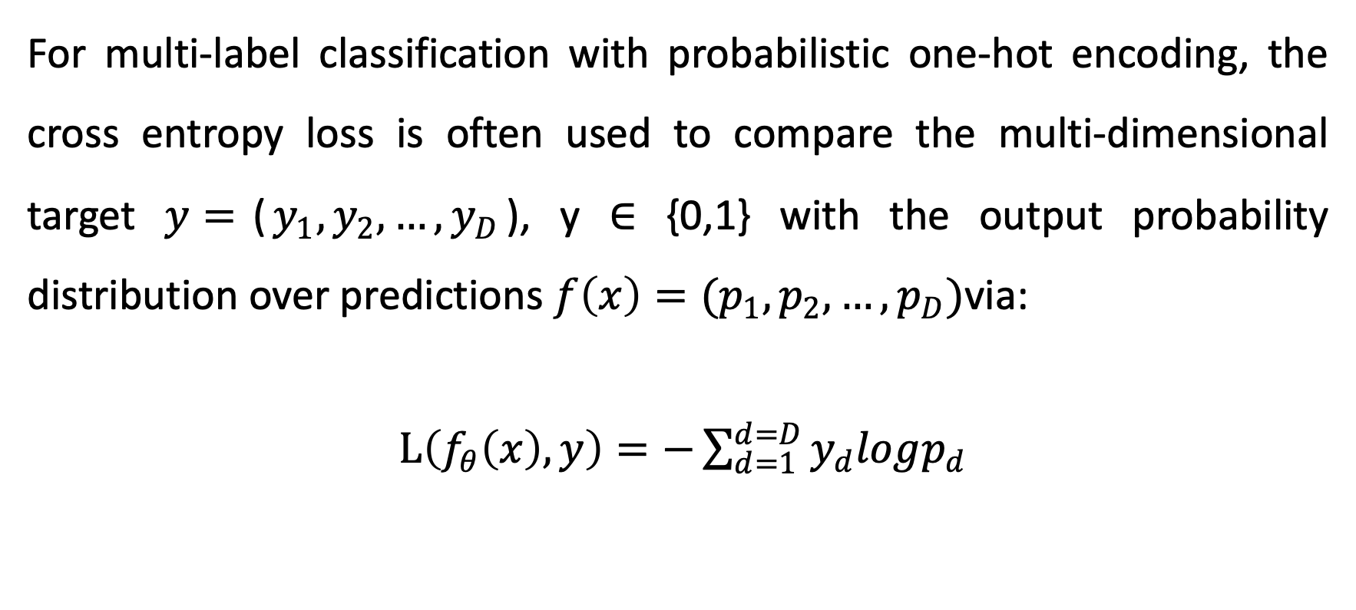
Loss In Multi-Label Classification
For multi-label classification with probabilistic one-hot encoding, the cross entropy loss is often used to compare the multi-dimensional target $y=$($y_{1},y_{2},…,y_{D}$), y ∈ {0,1} with the output probability distribution over predictions $f\left(x\right)=(p_{1},p_{2},…,p_{D})$via:
$L\left(f_{θ}\left(x\right), y\right)=−\sum_{d=1}^{d=D}{y_{d}logp_{d}}$

Slide 34
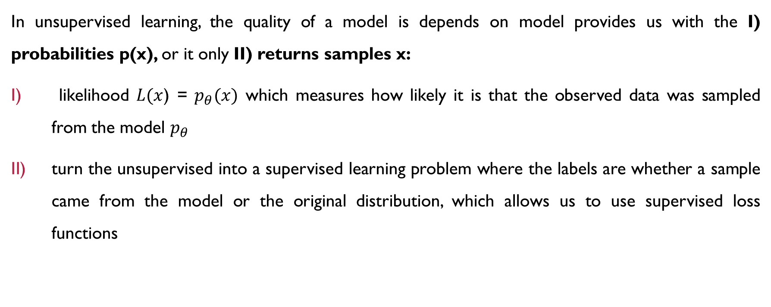
Loss In unsupervised learning
In unsupervised learning, the quality of a model is depends on model provides us with the I) probabilities p(x), or it only II) returns samples x:
likelihood $L(x$) = $p_{θ}(x)$ which measures how likely it is that the observed data was sampled from the model $p_{θ}$
turn the unsupervised into a supervised learning problem where the labels are whether a sample came from the model or the original distribution, which allows us to use supervised loss functions

Slide 35
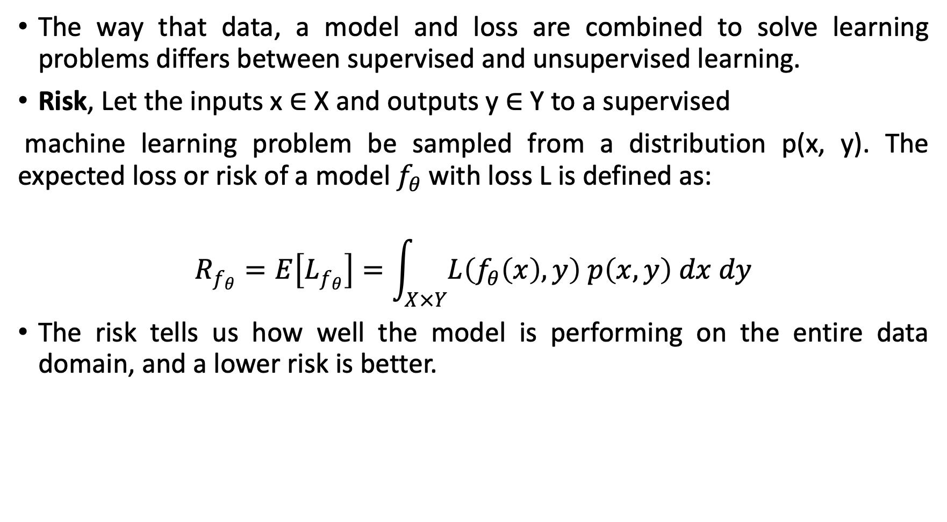
Risk Minimisation in Supervised Learning
The way that data, a model and loss are combined to solve learning problems differs between supervised and unsupervised learning.
Risk, Let the inputs x ∈ X and outputs y ∈ Y to a supervised
machine learning problem be sampled from a distribution p(x, y). The expected loss or risk of a model $f_{θ}$with loss L is defined as:
$$R_{f_{θ}}=E\left[L_{f_{θ}}\right]=\int_{X×Y}^{ }{L\left(f_{θ}\left(x\right), y\right) p\left(x, y\right) dx dy}$$
The risk tells us how well the model is performing on the entire data domain, and a lower risk is better.

Slide 36
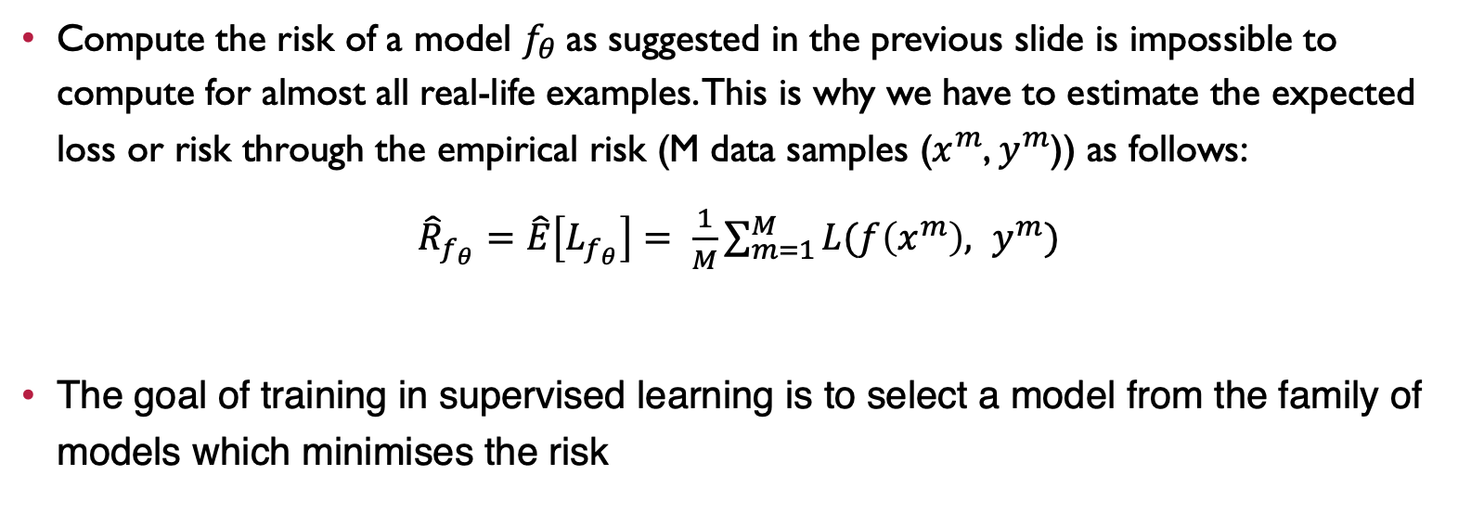
Empirical Risk as a Proxy
Compute the risk of a model $f_{θ}$as suggested in the previous slide is impossible to compute for almost all real-life examples. This is why we have to estimate the expected loss or risk through the empirical risk (M data samples ($x^{m}$, $y^{m}$)) as follows:
${\hat{R}}_{f_{θ}}=\hat{E}\left[L_{f_{θ}}\right]= \frac{1}{M}\sum_{m=1}^{M}{L(f\left(x^{m}\right), y^{m})}$
The goal of training in supervised learning is to select a model from the family of models which minimises the risk

Slide 37
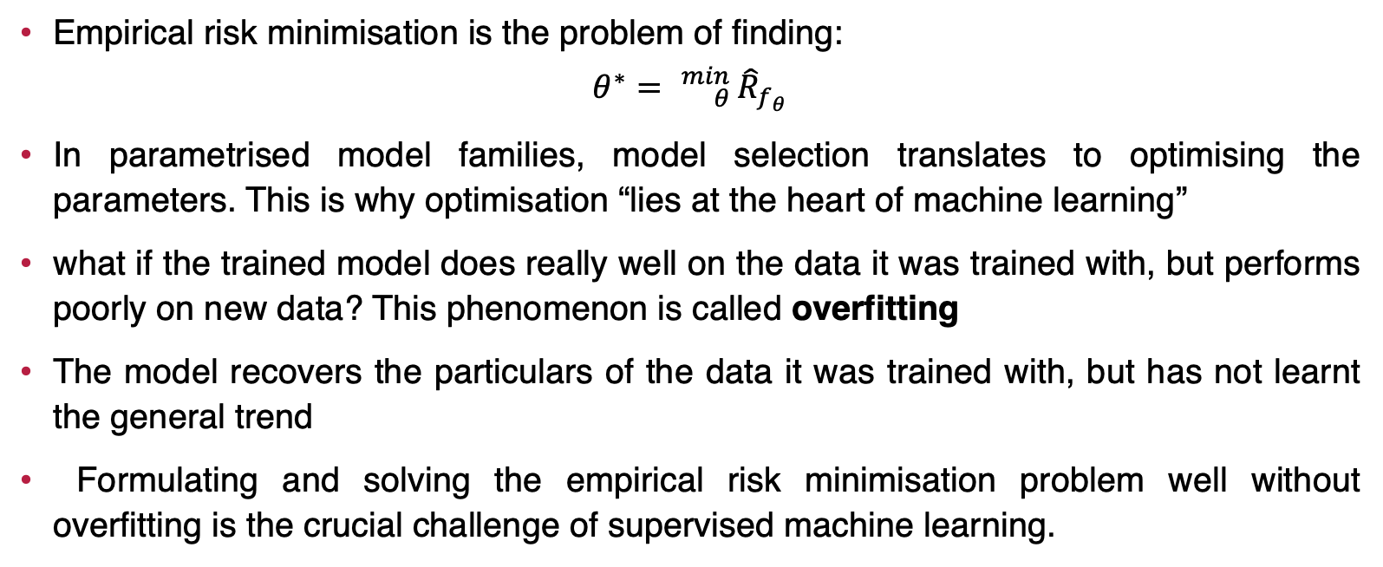
Empirical risk minimisation
Empirical risk minimisation is the problem of finding:
$$θ^{∗}= {}_{θ}^{min}{ {\hat{R}}_{f_{θ}}}$$
In parametrised model families, model selection translates to optimising the parameters. This is why optimisation “lies at the heart of machine learning”
what if the trained model does really well on the data it was trained with, but performs poorly on new data? This phenomenon is called overfitting
The model recovers the particulars of the data it was trained with, but has not learnt the general trend
Formulating and solving the empirical risk minimisation problem well without overfitting is the crucial challenge of supervised machine learning.

Slide 38
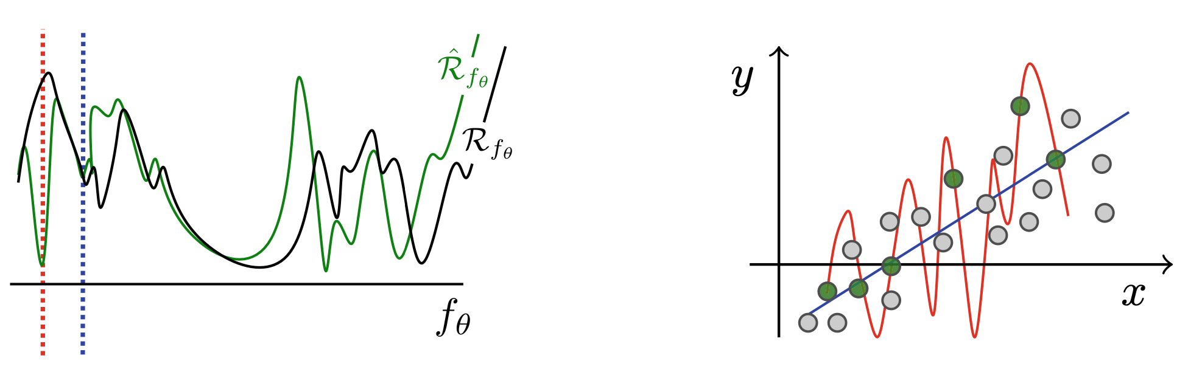
overfitting
A model that minimises the empirical risk (red dotted line in the left plot, corresponding to a model represented by the red line in the right plot) may perfectly reproduce the training data (green dots), but perform poorly to predict the labels of other data points (grey dots).

Slide 39
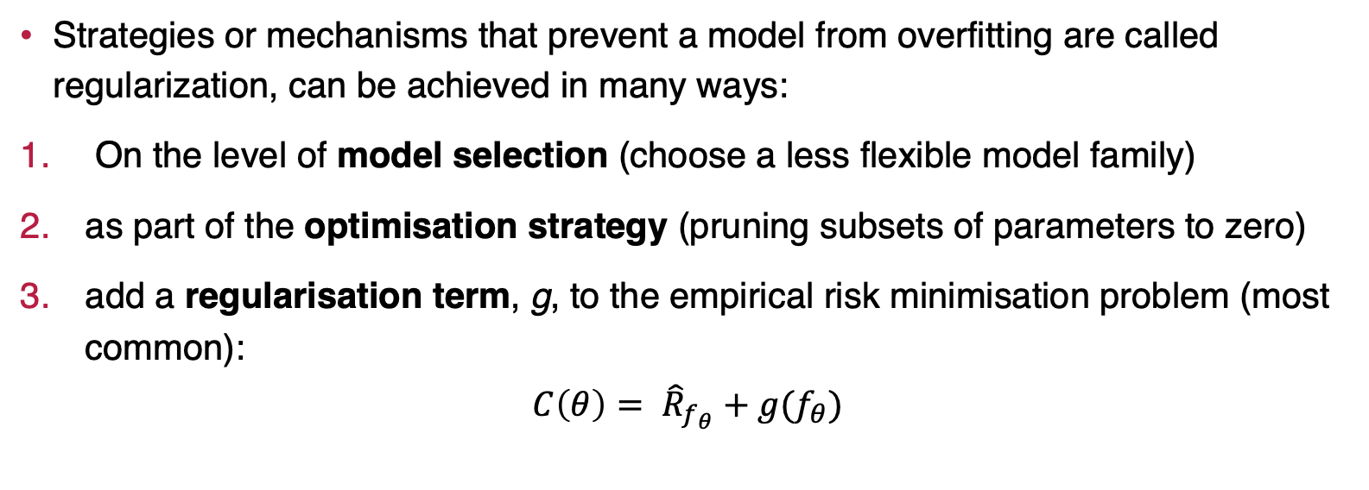
Regularisation
Strategies or mechanisms that prevent a model from overfitting are called regularization, can be achieved in many ways:
On the level of model selection (choose a less flexible model family)
as part of the optimisation strategy (pruning subsets of parameters to zero)
add a regularisation term, g, to the empirical risk minimisation problem (most common):
$$C\left(θ\right)= {\hat{R}}_{f_{θ}}+g(f_{θ})$$

Slide 40
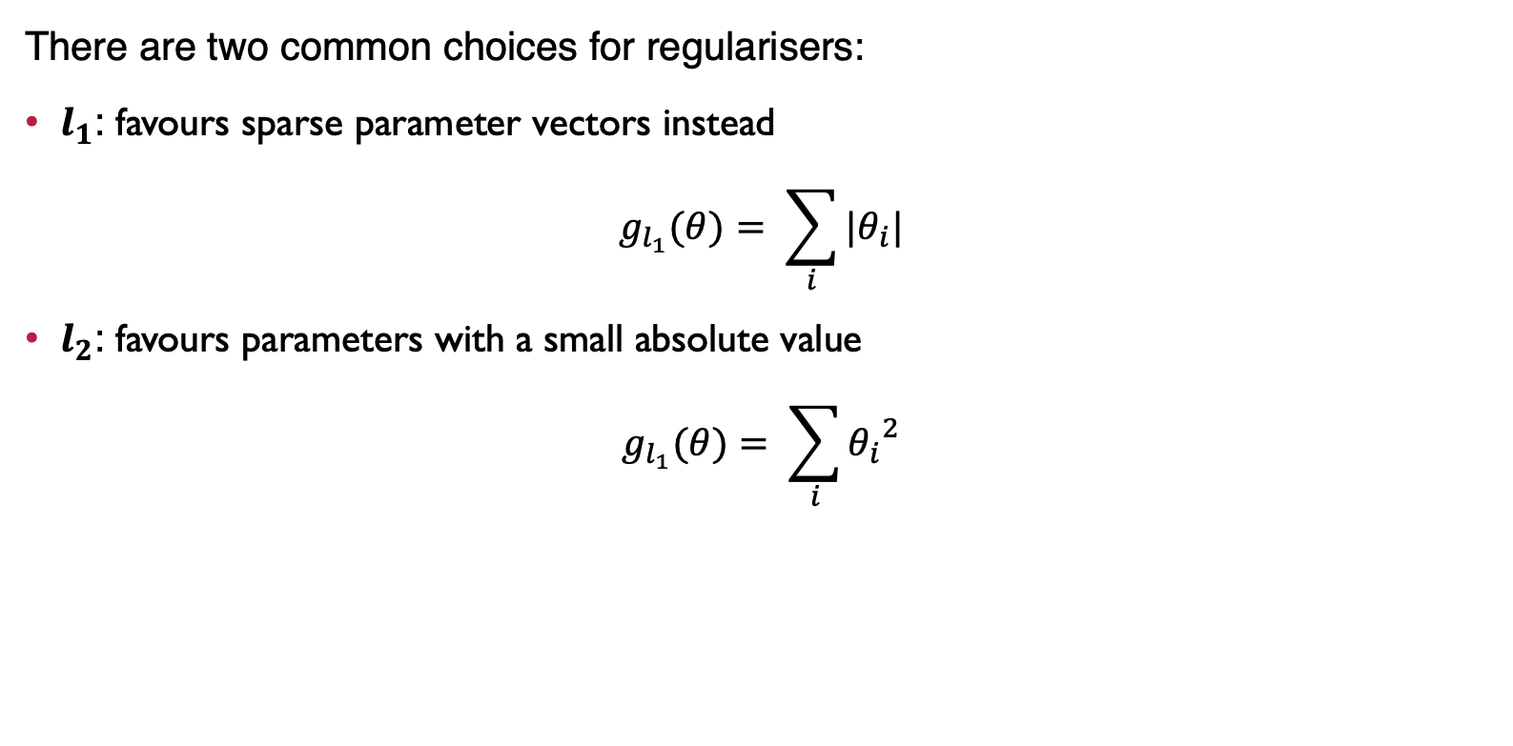
Types of Regularisation
There are two common choices for regularisers:
$l_{1}$: favours sparse parameter vectors instead
$$g_{l_{1}}(θ)= \sum_{i}{|θ_{i}|}$$
$l_{2}$: favours parameters with a small absolute value
$$g_{l_{1}}(θ)= \sum_{i}{{θ_{i}}^{2}}$$

Slide 41
Splitting entry dataset
If we use the entire labelled data set to train the model, we can compute how well it fits the data, but have no means to estimate the generalization performance. This is why one never trains with the entire dataset, but divides it into three subsets:
The training set is used to minimize the cost function
The validation set is used to estimate the performance after training in order to adapt hyperparamters
The test set is only touched once the model is fully specified. for the generalisation performance

Slide 42
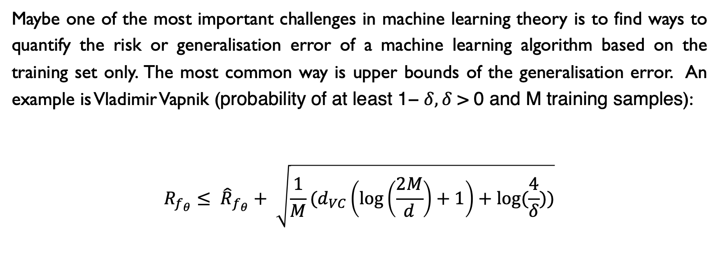
Quantifying Generalisation
Maybe one of the most important challenges in machine learning theory is to find ways to quantify the risk or generalisation error of a machine learning algorithm based on the training set only. The most common way is upper bounds of the generalisation error. An example is Vladimir Vapnik (probability of at least 1− $δ, δ$ > 0 and M training samples):
$${R_{f_{θ}}≤ \hat{R}}_{f_{θ}}+ \sqrt{\frac{1}{M}(d_{VC}\left(\log\left(\frac{2M}{d}\right)+1\right)+log⁡(\frac{4}{δ}))}$$

Slide 43
bias-variance trade-off
Last inequality states that we are interested in a low training error as well as a low
flexibility or capacity of the model family, This trade-off is often called the bias-variance trade-off.
A high bias is associated with models that are inflexible. They do not have the capacity to reproduce patterns in the data
To generalise well, a model has to be expressive or flexible enough to learn the pattern in the data, but must not have the capacity to overfit (i.e., it must have a low capacity).

Slide 44
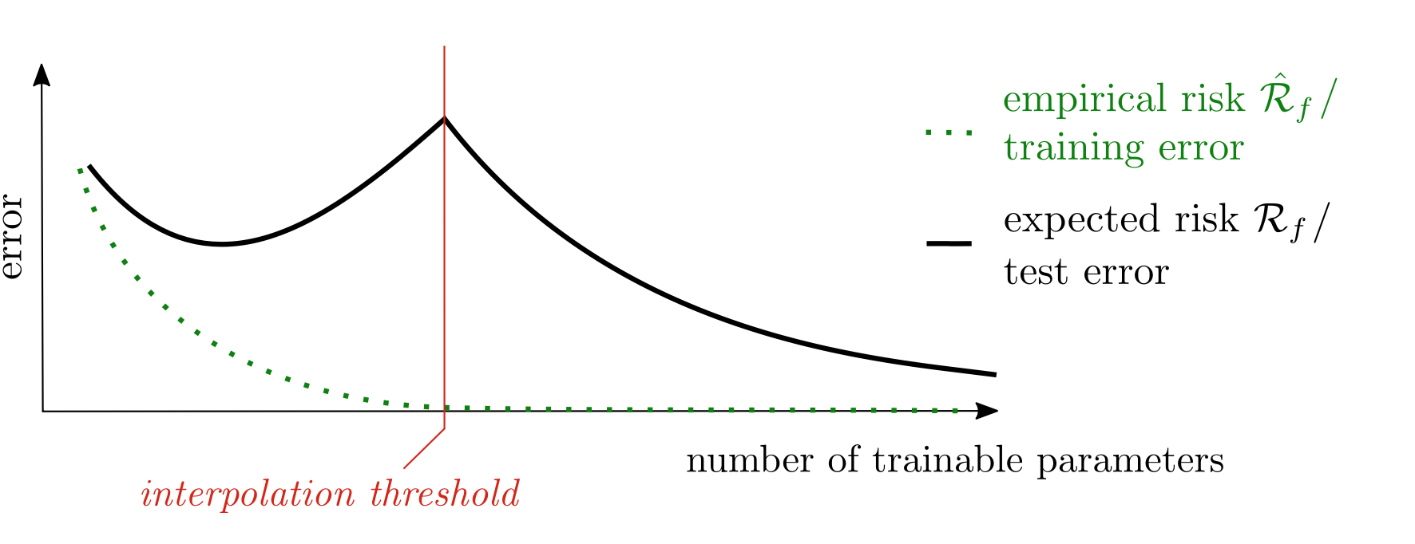
double descent
While traditional statistical learning theory believed that there was a sweet spot for a models family’s flexibility, modern deep learning shows a lot of evidence that after a threshold, heavily overparametrised models generalise increasingly better

Slide 45
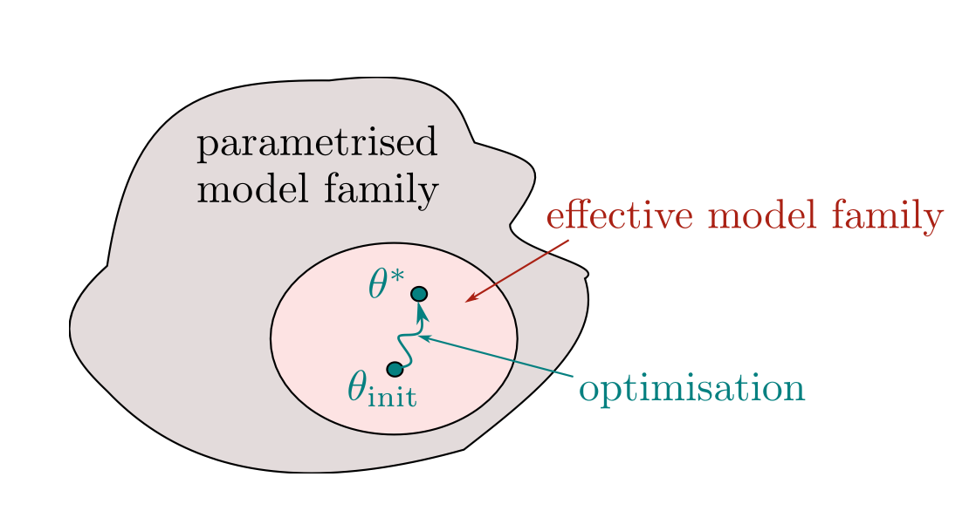
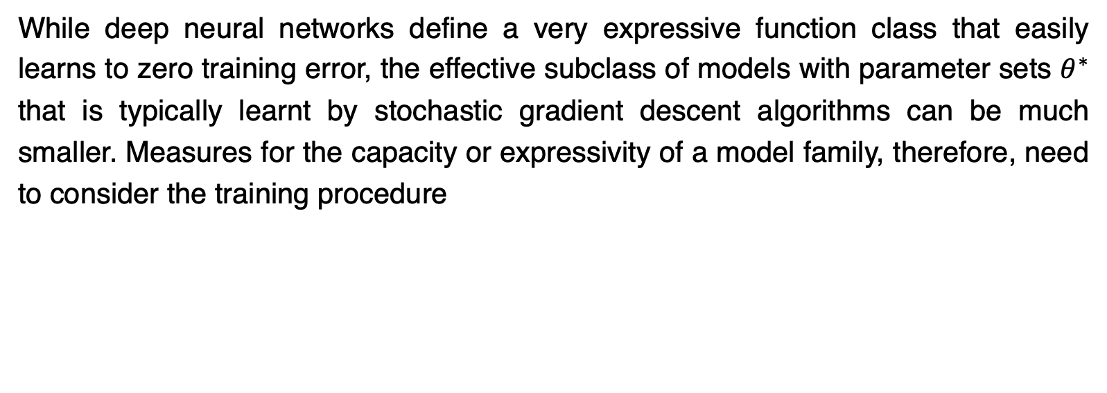
Effective model
While deep neural networks define a very expressive function class that easily learns to zero training error, the effective subclass of models with parameter sets $θ^{∗}$ that is typically learnt by stochastic gradient descent algorithms can be much smaller. Measures for the capacity or expressivity of a model family, therefore, need to consider the training procedure

Slide 46
convexity
Formulate machine learning as an optimization problem. This is why so much effort in machine learning goes into optimisation.
The most important distinction is between convex problems, and non-convex problems that are a lot harder to treat
A set is convex if a straight line connecting any two points in that set lies inside the set
A function f : X → R is convex if X is a convex domain and if a straight line connecting any two points of the function lies “above” the function
For general non-convex optimisation problems much less is known, and many machine learning problems fall into this category

Slide 47
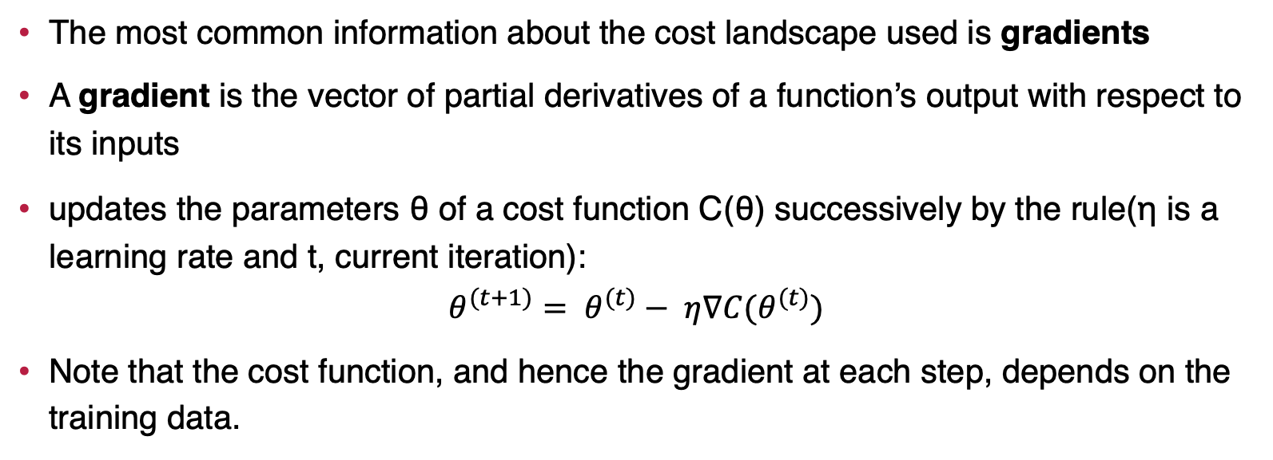
Gradient descent
The most common information about the cost landscape used is gradients
A gradient is the vector of partial derivatives of a function’s output with respect to its inputs
updates the parameters θ of a cost function C(θ) successively by the rule(η is a learning rate and t, current iteration):
$$θ^{(t+1)}= θ^{(t)}− η∇C(θ^{(t)})$$
Note that the cost function, and hence the gradient at each step, depends on the training data.

Slide 48
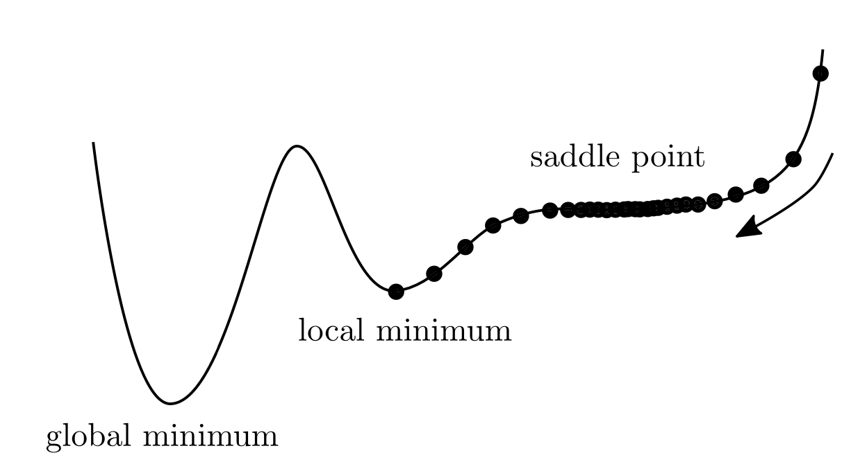
Gradient descent
Steps of the training updates in a one-dimensional parameter space. While being often the only option in high-dimensional non-convex optimisation, gradient descent can get stuck in local minima and convergence becomes slow at saddle points

Slide 49
Gradient descent
Stochastic gradient descent uses only a subset of the training data for each step, the more common version uses mini-batches of randomly sampled data and the batch size becomes a hyperparameter for training.
In gradient descent, the optimisation can get stuck in local minima or at saddle points, the stochastic nature tends to help escape these traps
Standard gradient descent is guaranteed to decrease the cost function in each iteration, stochastic gradient descent shows fluctuations in training

Slide 50
gradient descent
theme of stochastic gradient descent:
dynamically change the learning rate(exp, Adagrad or Adam optimisers)
change in parameters of step t dependent on the change step t− 1(Momentum and Adam optimisers)
Take geometric information on the curvature of the optimisation landscape (used by the natural gradient optimizer or second-order methods)

Slide 51
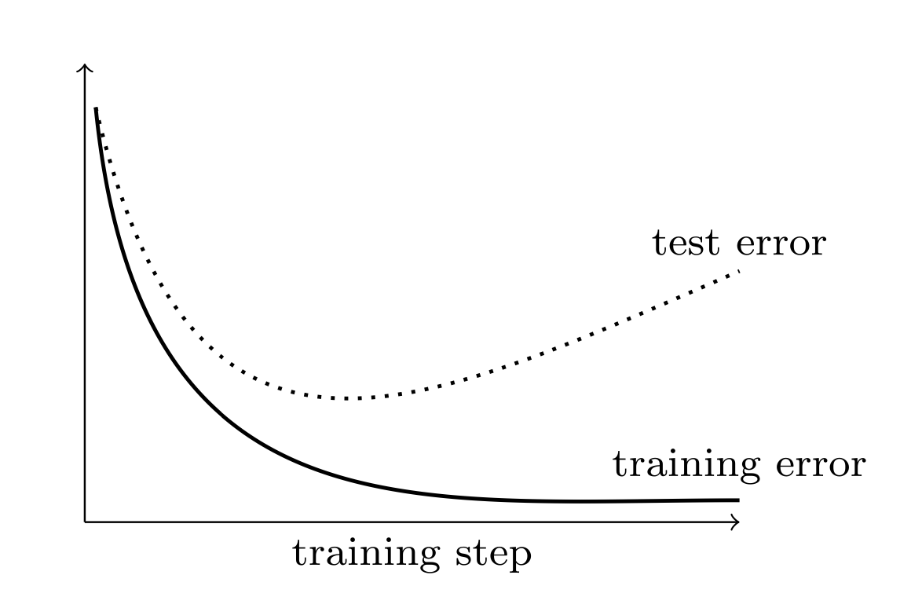
Gradient descent
Typical behaviour of the error on the training and test set during training. While the model learns to reduce the error on the training set, the test error usually begins to increase after a certain number of training steps, an indicator that the model begins to overfit.

Slide 52
Training in Unsupervised Learning
The training of unsupervised learning models is much less understood and a theoretical framework like risk minimisation in supervised learning
merit in unsupervised training is to achieve a small distance between the model distribution and the original data distribution.
If a probabilistic model is a density estimator, the standard framework for unsupervised learning is called maximum likelihood estimation(stems from a framework called Bayesian learning)

Slide 53
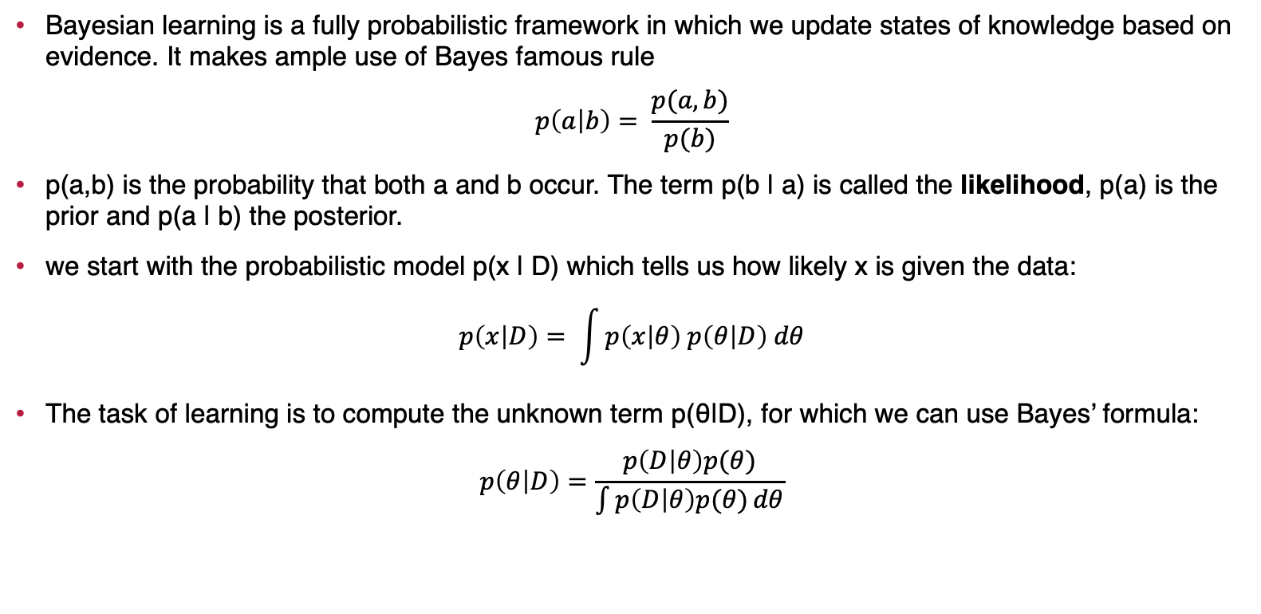
Bayesian learning
Bayesian learning is a fully probabilistic framework in which we update states of knowledge based on evidence. It makes ample use of Bayes famous rule
$$p\left(a | b\right)= \frac{p(a, b)}{p(b)}$$
p(a,b) is the probability that both a and b occur. The term p(b | a) is called the likelihood, p(a) is the prior and p(a | b) the posterior.
we start with the probabilistic model p(x | D) which tells us how likely x is given the data:
$$p\left(x | D\right)= \int{p\left(x | θ\right) p\left(θ | D\right) dθ}$$
The task of learning is to compute the unknown term p(θ|D), for which we can use Bayes’ formula:
$$p\left(θ | D\right)=\frac{p\left(D | θ\right)p(θ)}{\int{p\left(D | θ\right)p(θ)}dθ}$$

Slide 54
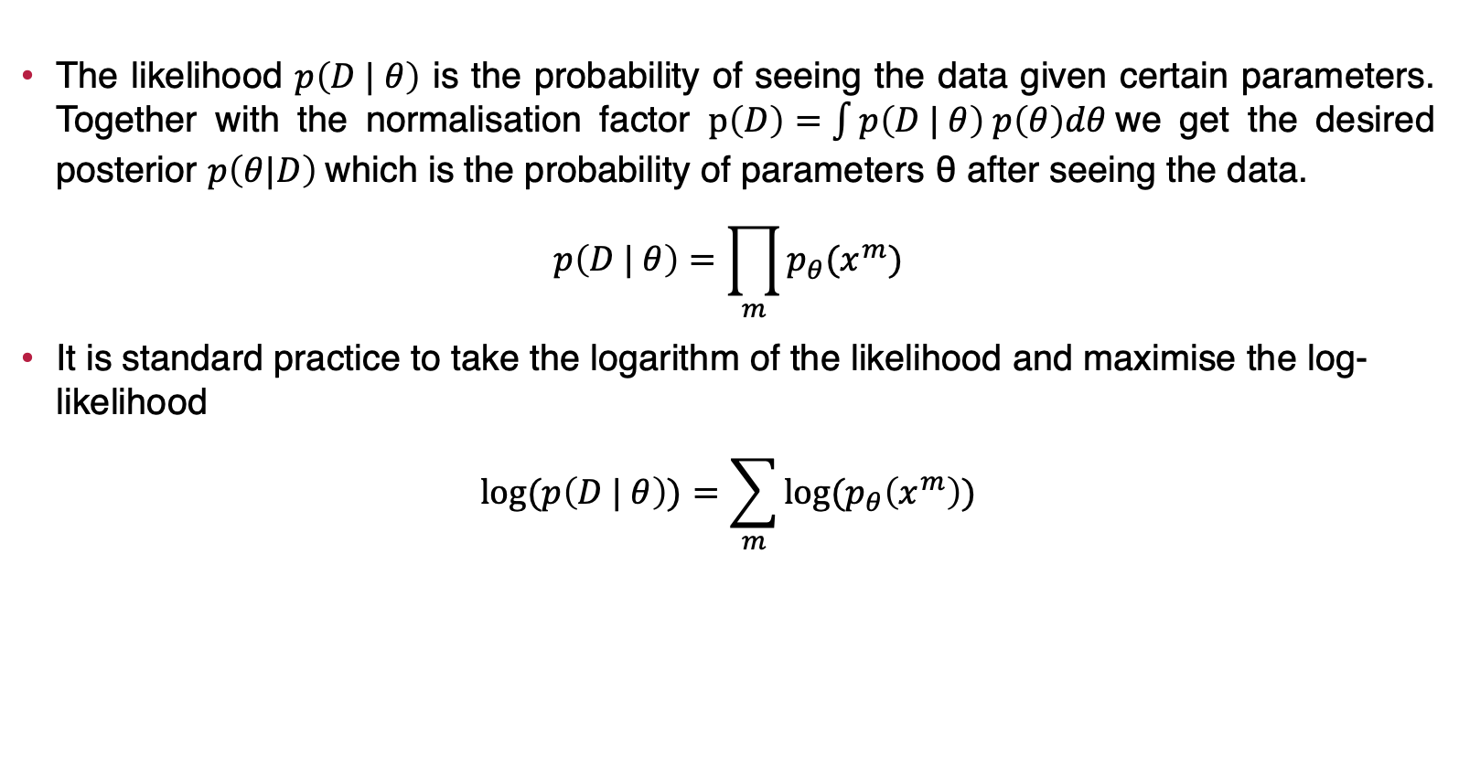
Bayesian learning
The likelihood $p\left(D | θ\right)$ is the probability of seeing the data given certain parameters. Together with the normalisation factor $p\left(D\right)=\int{p\left(D | θ\right) p\left(θ\right)dθ}$we get the desired posterior $p\left(θ|D\right)$which is the probability of parameters θ after seeing the data.
$$p\left(D | θ\right)=\prod_{m}{p_{θ}(x^{m})}$$
It is standard practice to take the logarithm of the likelihood and maximise the log-likelihood
$$log⁡(p\left(D | θ\right))=\sum_{m}{log⁡(p_{θ}\left(x^{m}\right))}$$

Slide 55
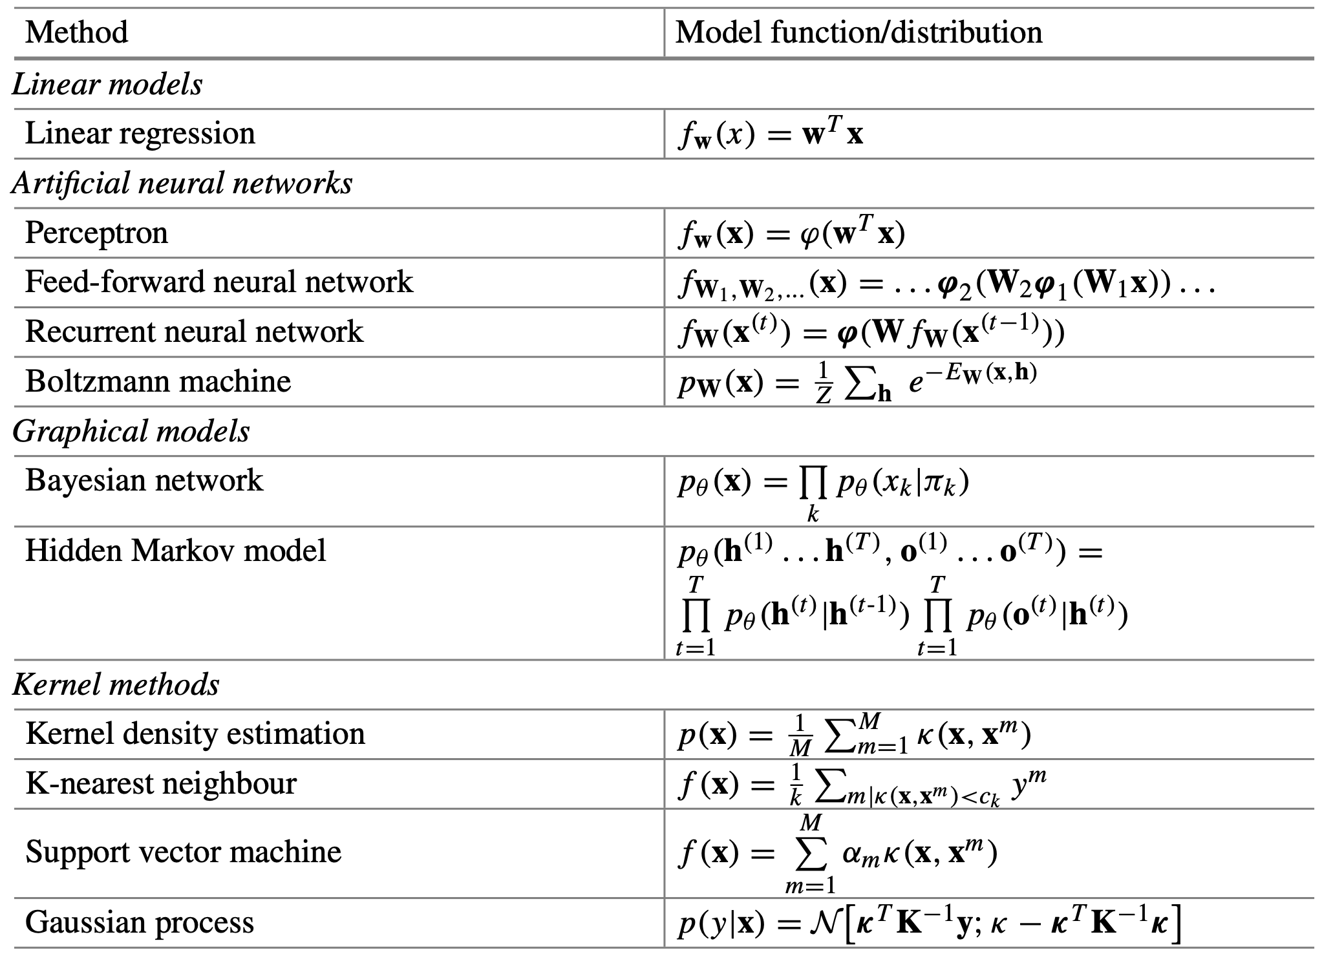
Methods in Machine Learning

Slide 56
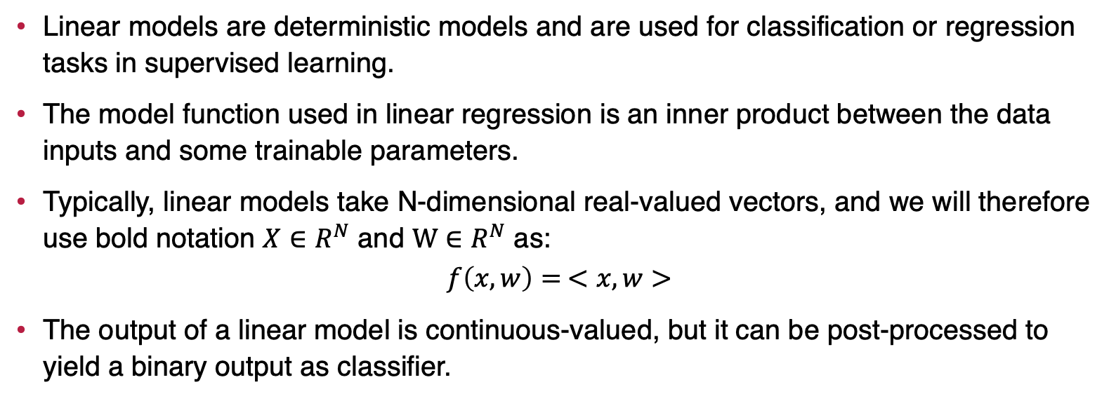
Linear Models
Linear models are deterministic models and are used for classification or regression tasks in supervised learning.
The model function used in linear regression is an inner product between the data inputs and some trainable parameters.
Typically, linear models take N-dimensional real-valued vectors, and we will therefore use bold notation $X∈R^{N}$ and $W∈R^{N}$ as:
$$f\left(x, w\right)= <x, w>$$
The output of a linear model is continuous-valued, but it can be post-processed to yield a binary output as classifier.

Slide 57
Neural Networks
Neural networks come in all shapes and sizes and can be probabilistic or deterministic models. Such as:
Perceptrons
Feed-Forward Neural Networks
Recurrent Neural Networks
Boltzmann Machines

Slide 58
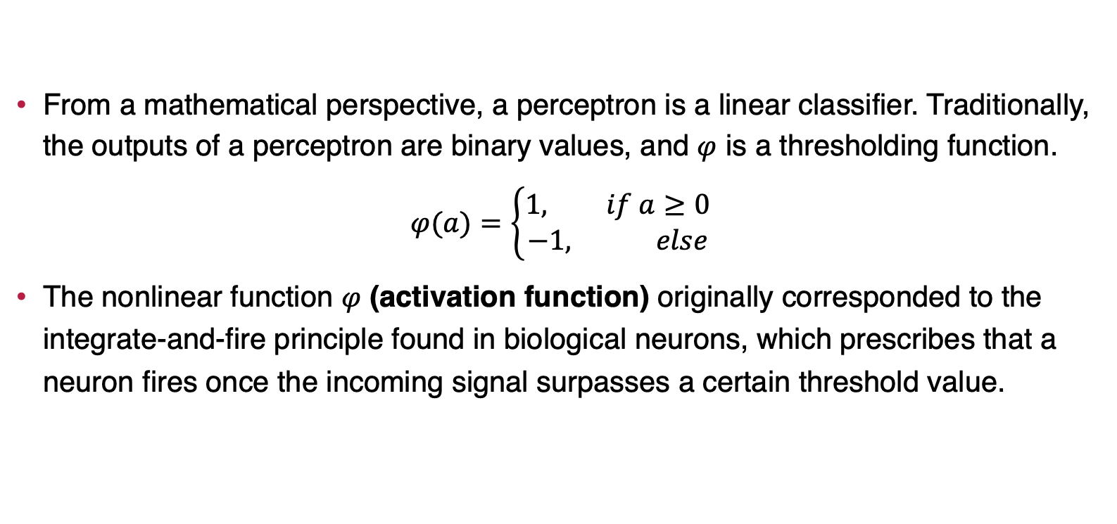
Perceptrons
From a mathematical perspective, a perceptron is a linear classifier. Traditionally, the outputs of a perceptron are binary values, and $φ$ is a thresholding function.
$$φ(a)=\left\{\begin{aligned}1, if a≥0 \\ −1, else\end{aligned}\right.$$
The nonlinear function $φ$ (activation function) originally corresponded to the integrate-and-fire principle found in biological neurons, which prescribes that a neuron fires once the incoming signal surpasses a certain threshold value.

Slide 59
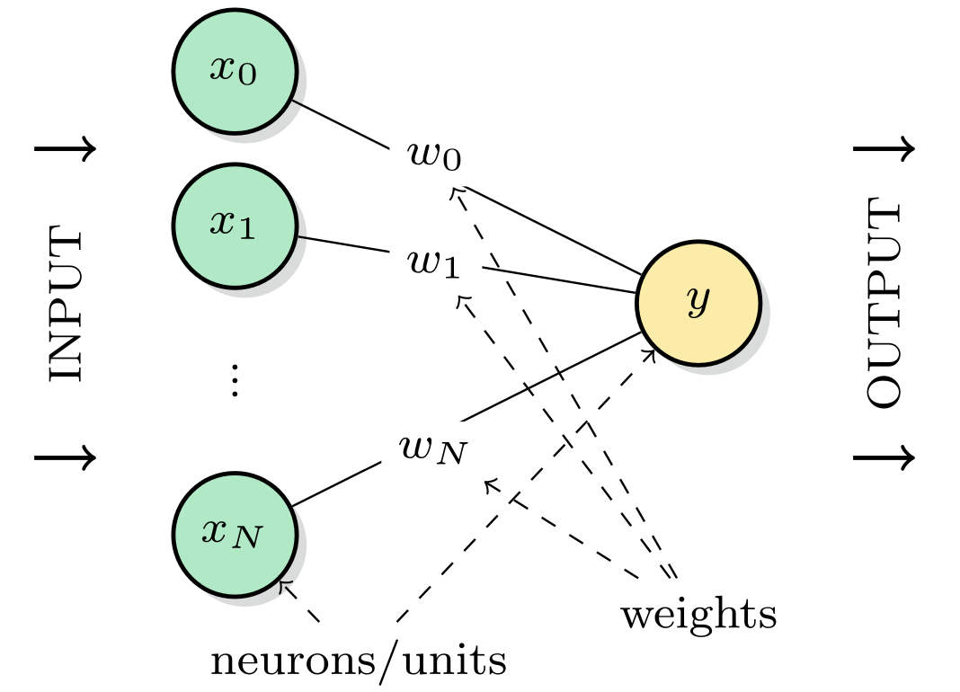
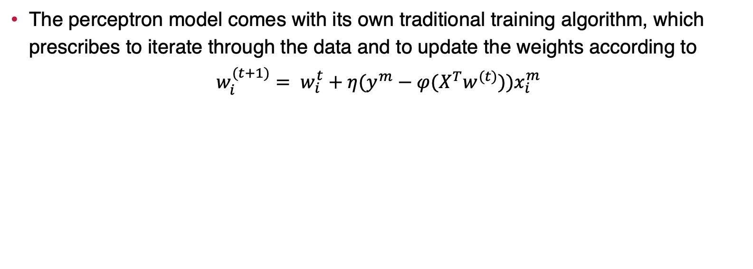
Perceptrons
The perceptron model comes with its own traditional training algorithm, which prescribes to iterate through the data and to update the weights according to
$$w_{i}^{(t+1)}= w_{i}^{t}+η(y^{m}−φ(X^{T}w^{(t)}))x_{i}^{m}$$

Slide 60
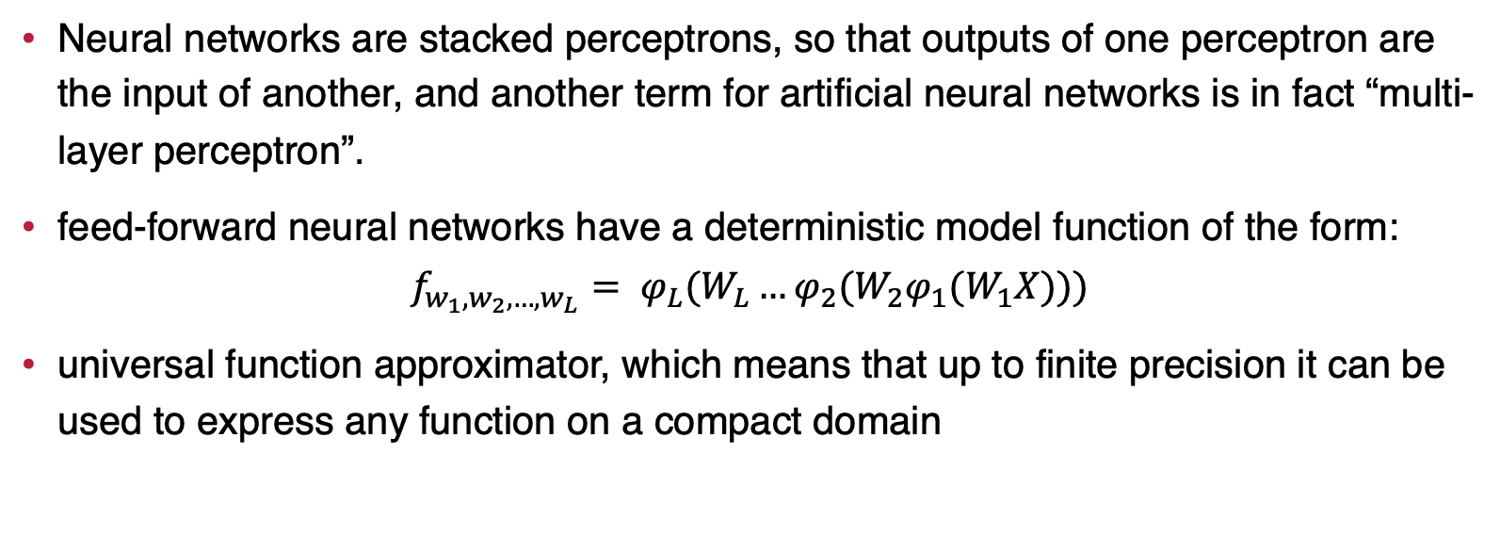
Feed-Forward Neural Networks
Neural networks are stacked perceptrons, so that outputs of one perceptron are the input of another, and another term for artificial neural networks is in fact “multi-layer perceptron”.
feed-forward neural networks have a deterministic model function of the form:
$$f_{w_{1},w_{2}, …,w_{L}}= φ_{L}(W_{L}…φ_{2}(W_{2}φ_{1}(W_{1}X)))$$
universal function approximator, which means that up to finite precision it can be used to express any function on a compact domain

Slide 61
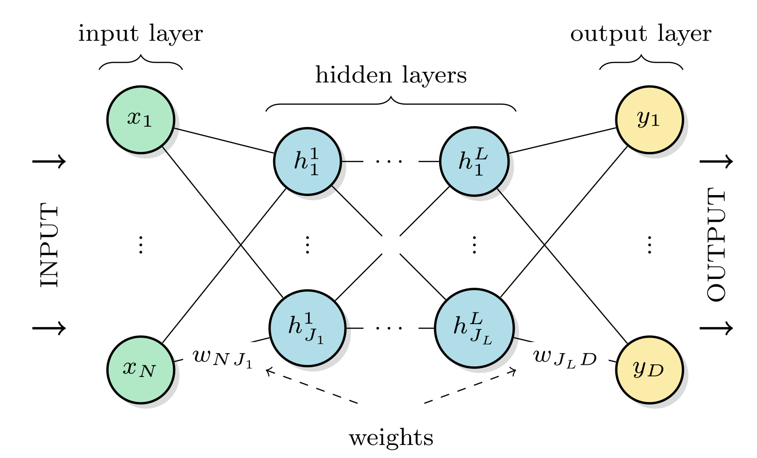
Feed-Forward Neural Networks
A feed-forward neural network feeds information forward through connected layers of perceptrons

Slide 62

activation functions
A feed-forward neural network can be combined with a variety of possible scalar-
valued activation functions.

Slide 63


backpropagation
The algorithm that computes the gradient or Jacobian of a neural network output with respect to its weights is called backpropagation.
Backpropagation defines how a backward pass “propagates” partial derivatives backwards through the network.
Neural network model used to explain the backpropagation algorithm. The green nodes denote the input layer encoding the input features, followed by the blue hidden layer with and the yellow output layer. The (vectorised) activation function of the hidden and output units are $φ_{1}$, $φ_{2}$, respectively. The weights are summarised in weight matrices W and Ω

Slide 64

Recurrent Neural Networks
While feed-forward neural networks are organised in layers, the graphical representation of recurrent neural networks is an all-to-all connected graph of units which are collectively updated in discrete time steps
The input can be understood as the state that some units $x_{1}^{(t)}, …,x_{N}^{(t)}$are set to at time t = 0.
The output can be read from one or more designated units $y_{1}^{(t)}, …,y_{N}^{(t)}$ at time t = T
The state of the network after each update is given by:
$$S^{(t+1)}=φ(WS^{t})$$
where the $R^{G×G}$ matrix W contains the weights as before and $φ$ is a vectorized nonlinear activation function.
One relatively simple class of recurrent neural networks for a task called pattern matching or associative memory are Hopfield neural networks

Slide 65

Recurrent Neural Networks
A recurrent neural network is represented by an all-to-all connected graph, does not have self-connections of nodes and where connections have symmetric weights

Slide 66

Boltzmann Machines
Boltzmann machines are recurrent neural networks that define the probability distribution of a probabilistic model over the states of the binary units s.
Usually, formulated as models for unsupervised learning’
It turns out that general Boltzmann machines are hard to train and the model only became popular when an efficient training algorithm for restricted Boltzmann machines was found
In a restricted Boltzmann machine (RBM), W only contains connections between visible and hidden units.
The cost function is commonly chosen as maximum log-likelihood estimation ( $x^{m}$is mth training data point):
$$C\left(W\right)= \sum_{m=1}^{M}{\log{p_{w}(x^{m})}}$$

Slide 67

Boltzmann Machines
Graphical representation of a restricted Boltzmann machine visible units include input and output units. A full Boltzmann machine would also allow for connections in between hidden units as well as in between visible units

Slide 68
Graphical Models
Graphical models are probabilistic models that use graphical representations to display and simplify probability distributions over data. Such as:
Bayesian Networks Models
Hidden Markov Models

Slide 69

Bayesian Networks
A Bayesian network or belief network is a probabilistic model with conditional independence assumptions that simplify the model distribution p(s), which follows directly from the definition of a conditional probability
probability distribution over s can be expressed by
$$P\left(s\right)= \prod_{i=1}^{G}{p(s_{i}|π_{i})}$$
$π_{i}$ is the set of variables that $s_{i}$ conditionally depends on

Slide 70

Bayesian Networks
The variable Rain is conditionally independent of the other two variables, while the variable Sprinkler is only conditionally independent from the variable Grass wet. If one knows the value of Rain (the input) and one wants to derive the probability of “Grass wet” (the output), the Sprinkler becomes a hidden variable over which one has to marginalise. Each variable comes with a local probability table listing the probability of the state of this variable given the state of the parents

Slide 71
Hidden Markov Models
Hidden Markov models are graphical models whose properties are a bit different from the preceding methods, as they describe sequences of “chained events”
the inputs and outputs of the hidden Markov model are sequences of values of random variables.
A Markov process is a stochastic process where the state of the system changes according to the transition probabilities
The Markov property refers to the fact that the current state only depends on the previous one, but not on the history of the sequence.
A hidden Markov model can be used to find the most likely state sequence H(T ) given an observation O(T ), which is a typical supervised pattern recognition problem
applications such as text prediction, DNA analysis and online handwriting recognition

Slide 72

Hidden Markov Models

Slide 73

Kernel Methods
Kernel methods solve machine learning tasks based on the idea of a similarity measure between data points.
For example, the similarity measure can be used to compare a new data point to training samples in a classification task, and the prediction could pick the most common label among close training samples

Slide 74


Kernel Density Estimation
Kernel density estimation [2] for pattern classification constructs a probabilisti model from data based on a simple idea: given a similarity measure or kernel on the input space, the model distribution is defined as:
$$p\left(x\right)= \frac{1}{M} \sum_{m=1}^{M}{κ(X − X^{m})}$$
This is the sum of a distance measure $κ$ between all M training inputs

Slide 75


K-Nearest Neighbour
The k-nearest neighbour method is one of the simplest classification algorithms. Given the dataset, one selects the k closest training inputs relative to the new input X according to the similarity metric of choice. The prediction y can be chosen according to the majority class amongst the neighbours for a classification task or as the average of their target outputs for regression tasks.

Slide 76

Support Vector Machines
Support vector machines are one of the most well-known kernel methods, and are typically used for classification
The specific definition derives from their initial introduction as maximum-margin classifiers, which prescribes that training should maximise the distance between the decision boundary of a classifier and the training vectors
A support vector machine is derived from the problem of finding the discriminant hyperplane with the largest margin to the input vectors. The figure shows the geometric construction of the expression for the distance Δ of the margin

Slide 77


Gaussian Processes
Gaussian processes are a kernel method with again a rather different approach. Assume we have a supervised regression task with $X= R^{N}, Y=R$. The idea is to assign a probability to every possible model function f (x)
The covariance determines the smoothness of the sample functions. The training data points reduce the space of possible functions and introduce certainty where the data values are. Samples from the posterior (right) are, therefore, reduced to model functions that agree with the data points.

Slide 78

END of Chapter 2

